Slide 1
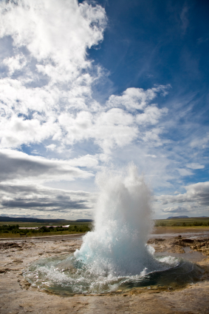
Peppermill Renewable Energy Program
Geothermal
One of the Greatest Renewable Energy’s Available
Review Peppermill’s Geothermal Story

Slide 2
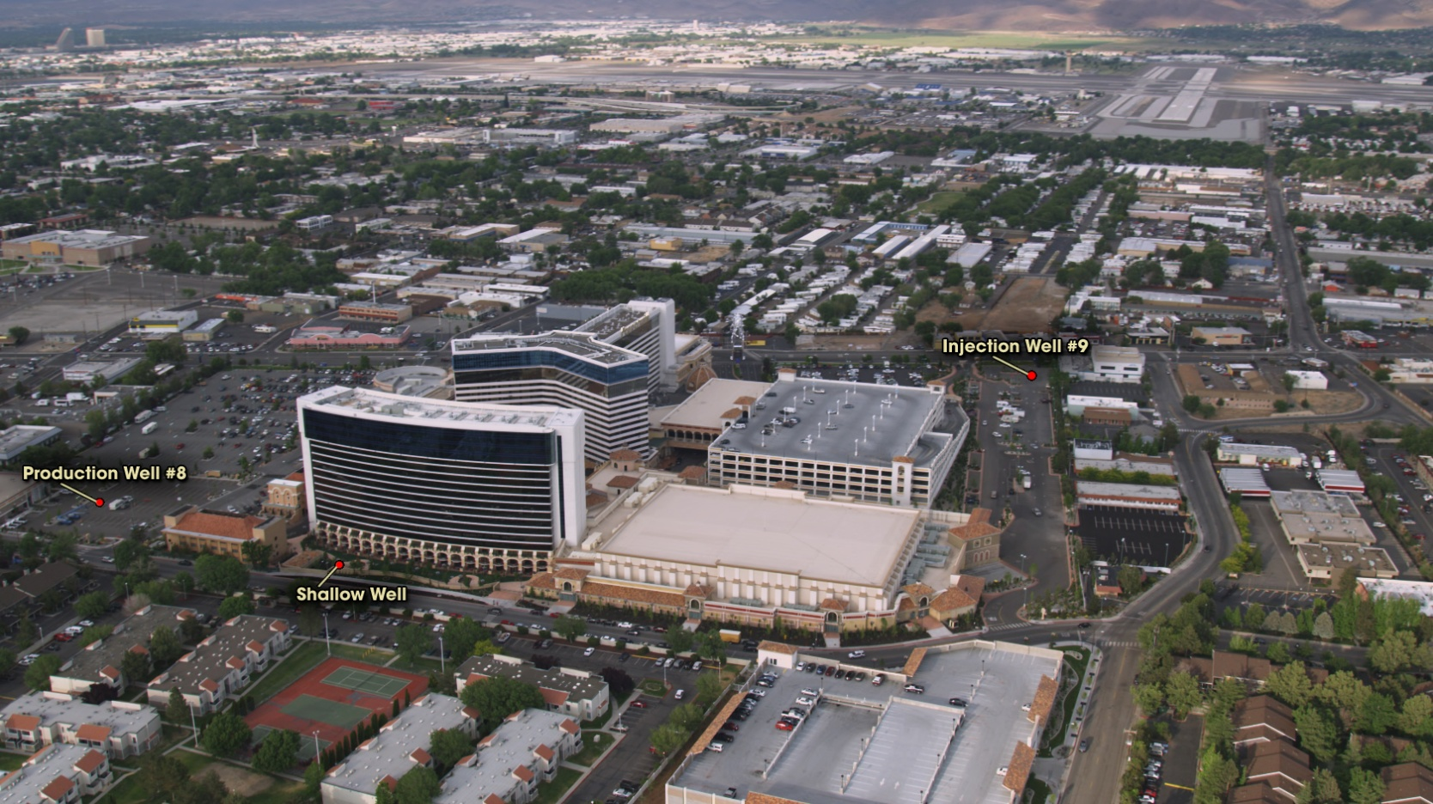
Peppermill Renewable Energy Program
5 Year Expansion
Property doubled in size
  60 Acre Resort
  2.2 Million Square Feet of Facility
  1,640 hotel rooms
  9 Restaurants
  200,000 sq. ft convention space
  3 swimming pools

Slide 3

Peppermill Renewal Energy Program
Real Time Concerns
Second largest energy user in Reno.
Utility bills (gas, electricity & water) doubled
Economy slowed down – affecting revenue.
Started researching renewable energy alternatives.

Slide 4
Peppermill Renewable Energy Program
Natural Gas Consumption
Therm $ Before Geothermal
Therm $ After
Geothermal

Slide 5
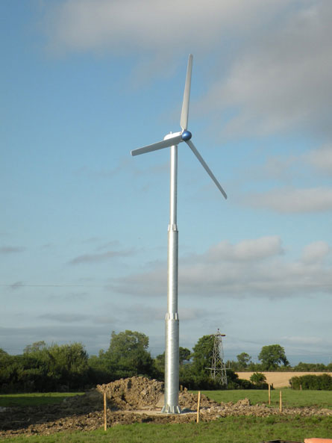
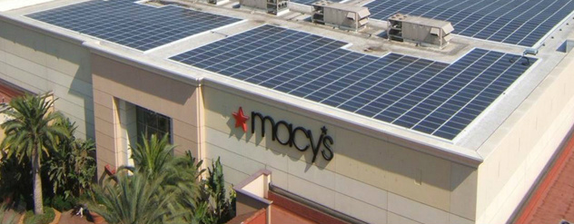
Peppermill Renewable Energy Program
Renewable Energy Alternatives
Reviewed energy resources available
Choosing best energy
Cost & expenses involved
Methods of obtaining the resource
Risks
Rate of return on investment

Slide 6
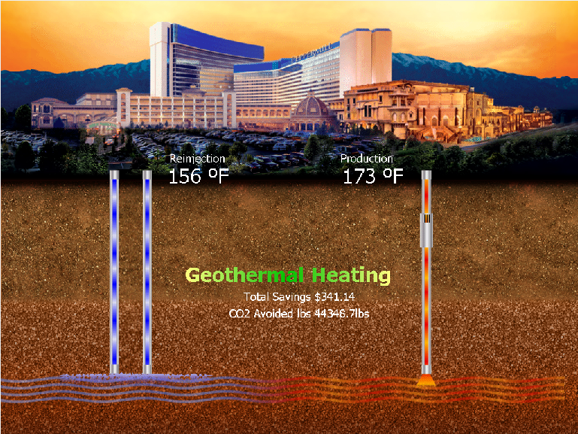
Peppermill Renewable Energy Program
Choosing Geothermal
  Shallow Well Operations since 1980’s
  Active geothermal reservoir underground
  Energy not utilized to it’s fullest capacity.
  Heated small outer building & pool.

Slide 7
Peppermill Renewable Energy Program
2008 Hotel Expansion
Completely over-hauled: Shallow Geothermal System
Installed new: - Stainless Steel Piping - Heat Exchangers - New Well Pumps - VFD drives - Water Holding Tanks - Front End Connections

Slide 8
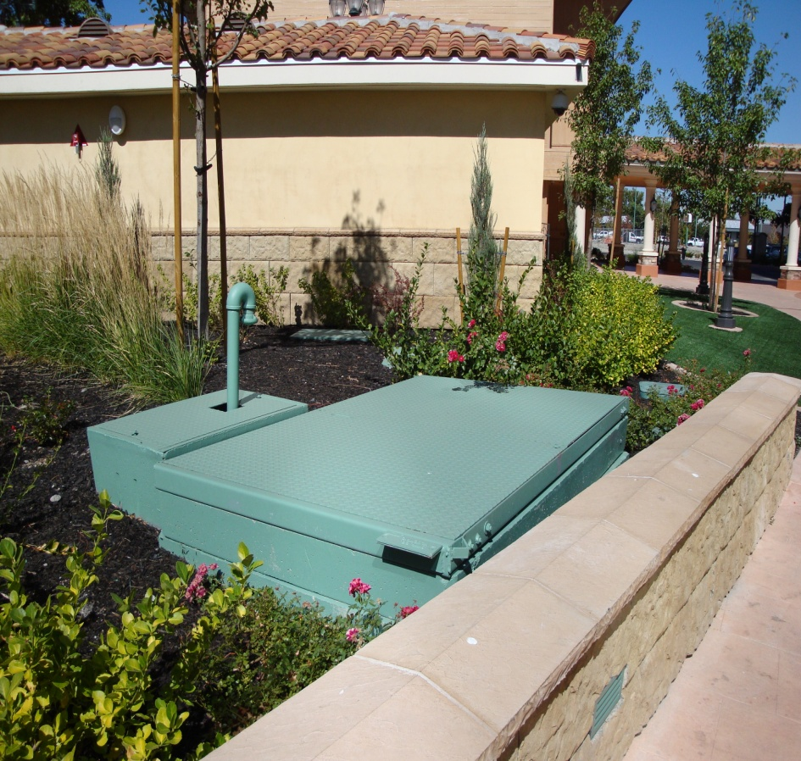
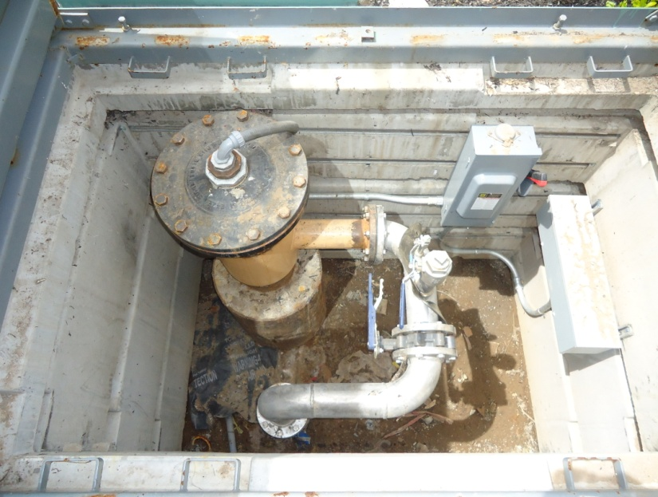
Peppermill Renewable Energy Program
Production Well #2
  Drilled early 1980
  Casing - 6”
  Depth - 934’
  Temp - 128 deg
  GPM - 175
  25HP Hayes 6 - stage pump
  Pump depth – 200’

Slide 9
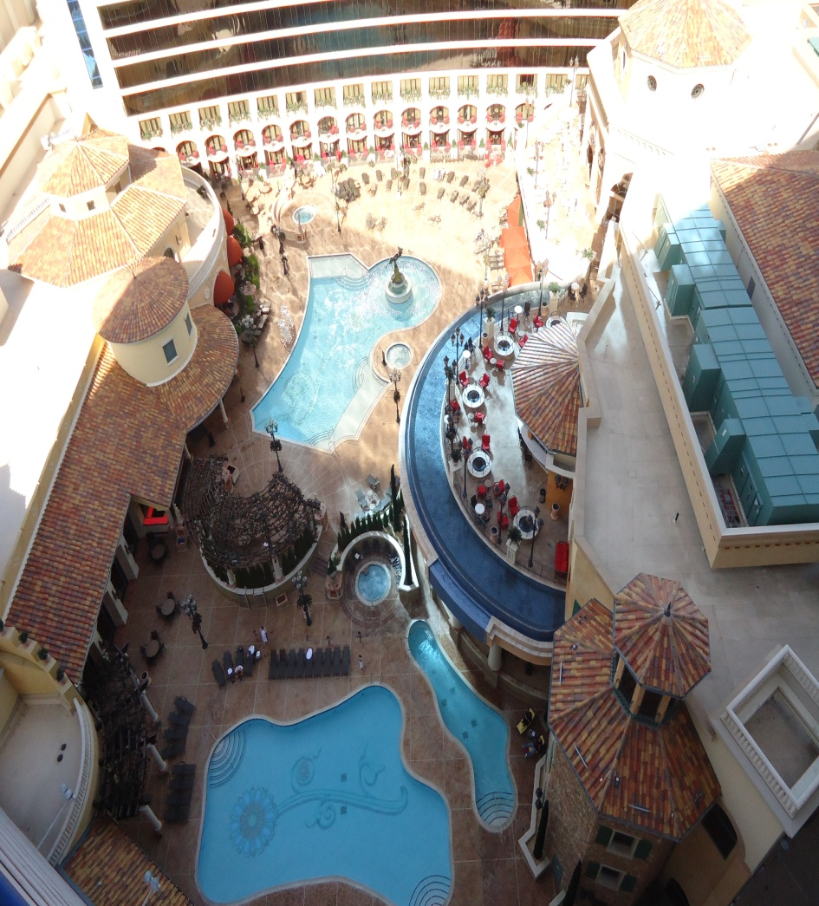
Peppermill Renewable Energy Program
Shallow Well – Heated:
  600 Suite Hotel – Domestic water
  Two main swimming pools
  Two Jacuzzi pools
Reduces Central Plant NG Boiler heat load by 30%
1.5 Year pay back

Slide 10
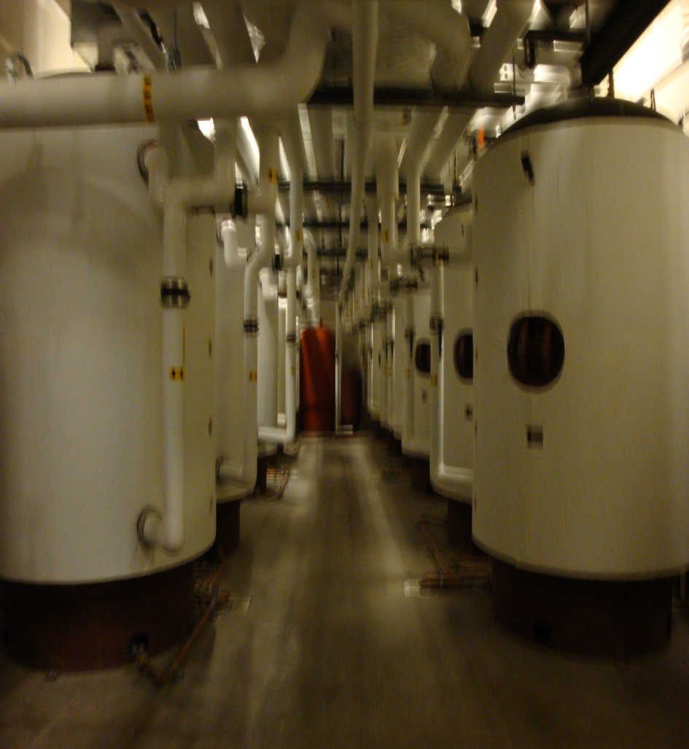
Peppermill Renewable Energy Program
Expansion Tanks
  Stores domestic water heated by Geothermal
  Heats Tuscan Tower domestic hot water
    12 – 1,000 gallon holding tanks
    127 degree water
    Supplies hot water to showers & bathrooms

Slide 11
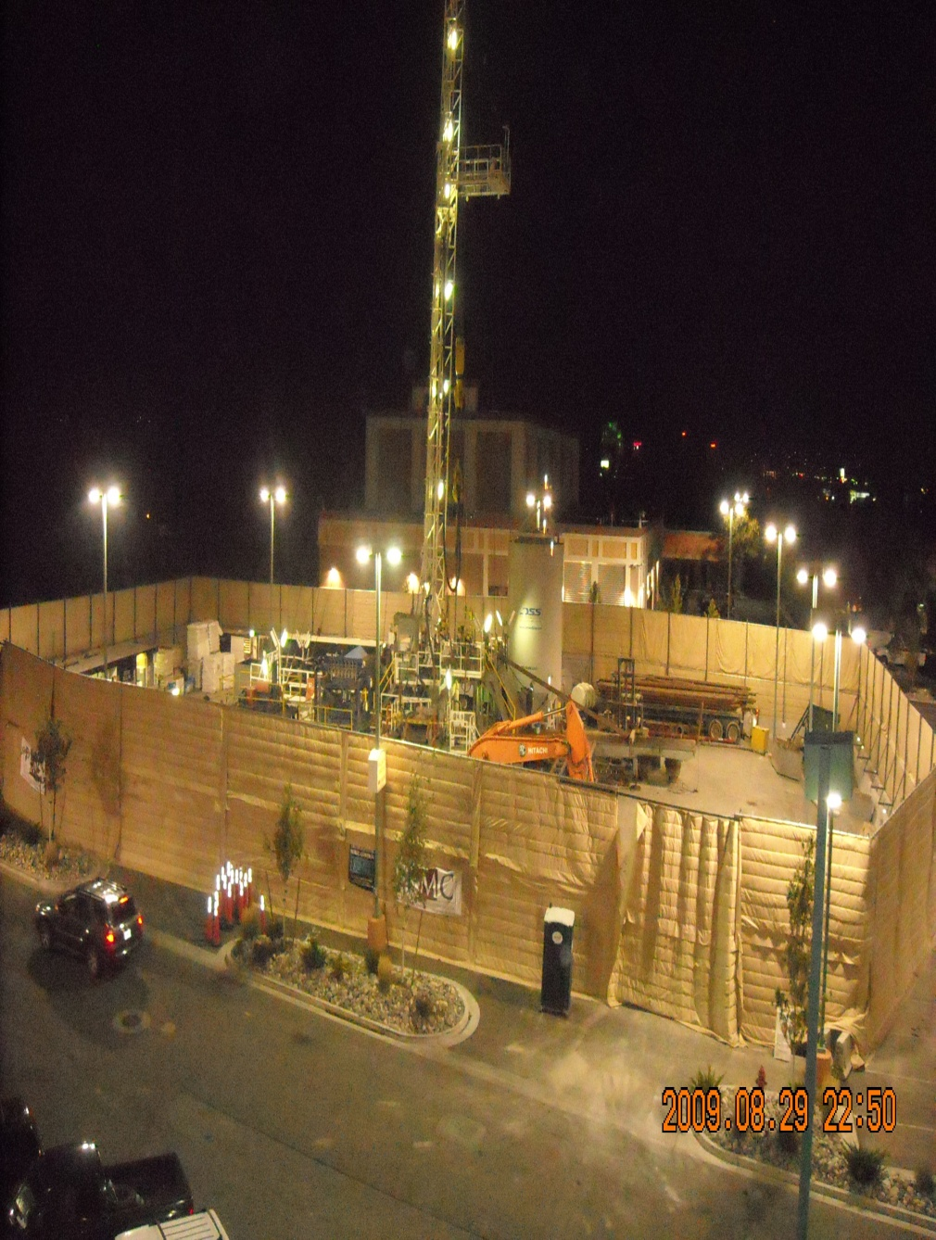
Peppermill Renewable Energy Program
New Production Well - #8
  Ensign Drilling Co.
  28 days to drill
  24/7 Operation
  South Central Plant Lot
  Sound Barrier Walls - Noise concerns - Neighbors

Slide 12
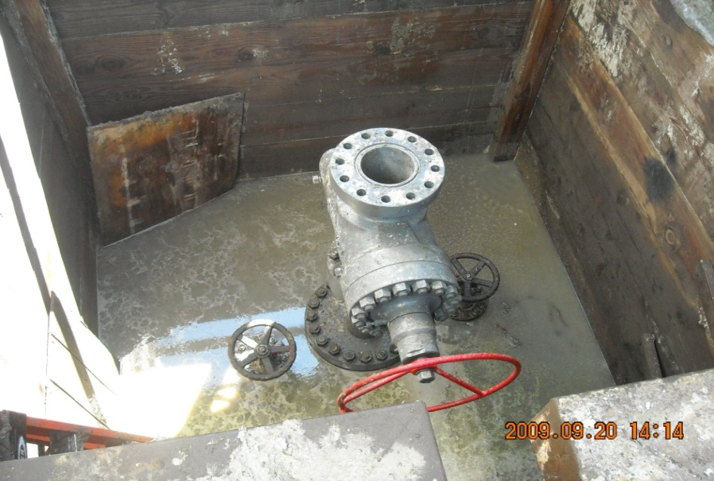
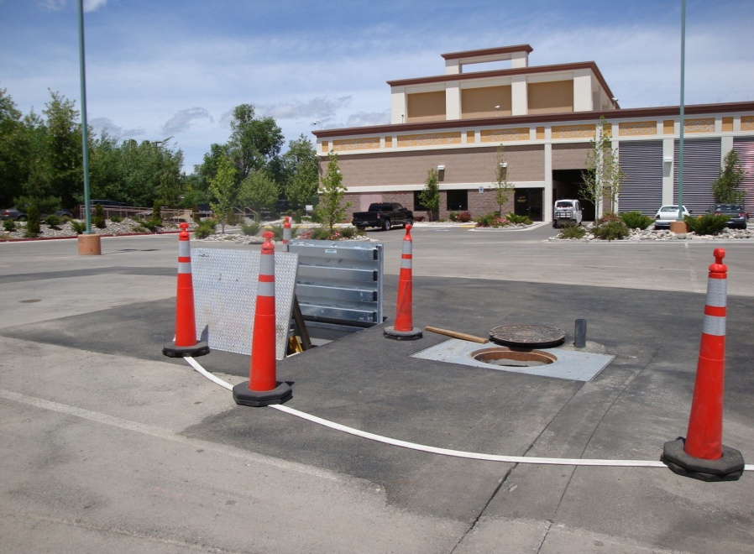
Peppermill Renewable Energy Program
New Production Well - #8
  4,421’ Vertical
  9 5/8” Well Casing
  Flows Artesian @ 38 psig
  Produces 1,500 GPM
  174 degree fluids
  Provides 100% campus heat load

Slide 13
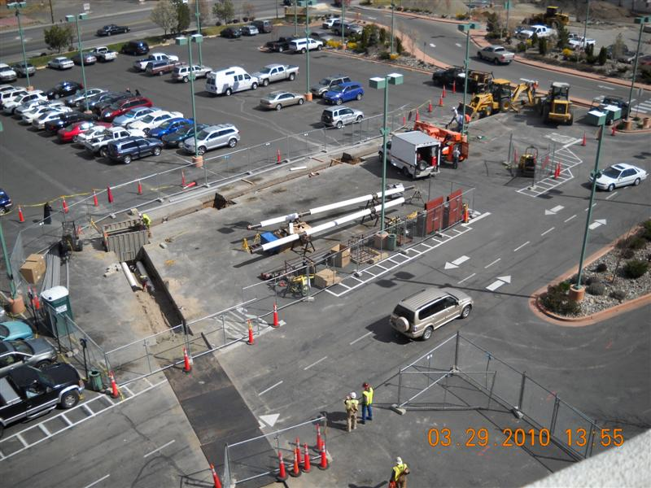
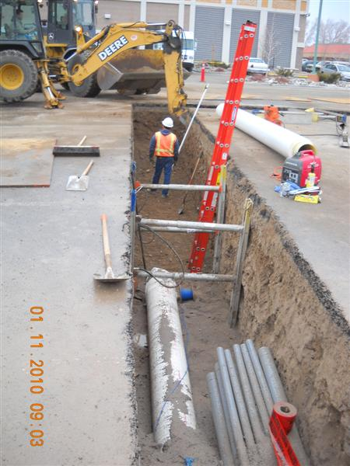
Peppermill Renewable Energy Program
Trenching Operations
PW #8 to IW #9 piping
1,500’ of new 10” piping
Schedule 80, black steel, seamless – 1,070 p.s.i.g
Communication and power
Traffic control, noise, storm drain protection.

Slide 14
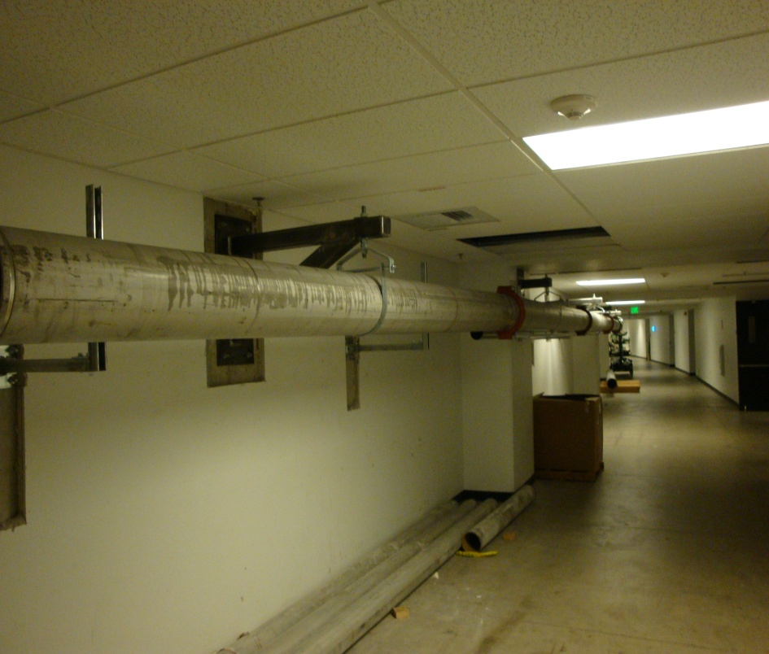
Peppermill Renewable Energy Program
Reinjection Piping
  Engineering Challenges
  Pipe fabricated through Hotel Tower corridor’s
  Connects Production Well #8 to Injection Well #9

Slide 15
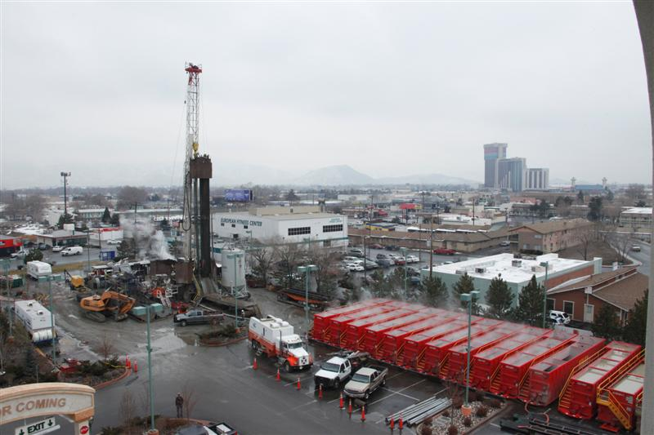
Peppermill Renewable Energy Program
New Reinjection Well #9
  IW #9 – Drilled in January 2010
  Ensign Drilling Derrick – 127 feet high
  Geothermal Fluid flow test
  Baker Hughes Tanks

Slide 16
Peppermill Renewable Energy Program
Injection Well #9
Vertical Bore Hole Schematic
  30” Ground level casing
  9.6” Casing at the bottom
  Well is 3,900’ deep
  Handle 1,500 GPM

Slide 17
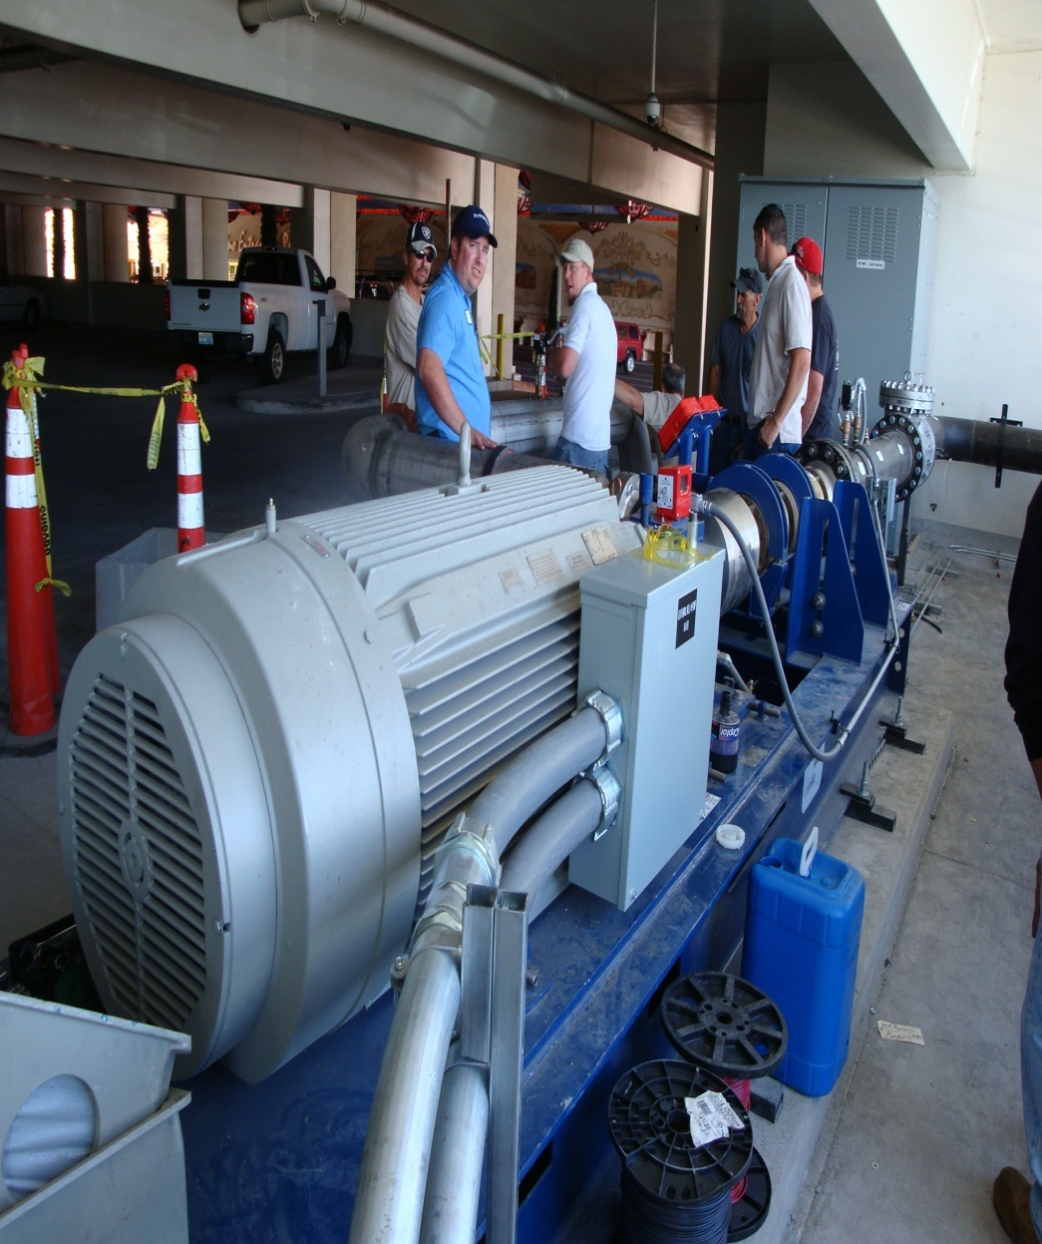
Peppermill Renewable Energy Program
Baker Hughes Injection Pump
Horizontal skid layout
4 – stage 1,000 series pump
400 Hp Tyco Motor
Pumps geothermal fluids back into aquifer
600 p.s.i.g

Slide 18
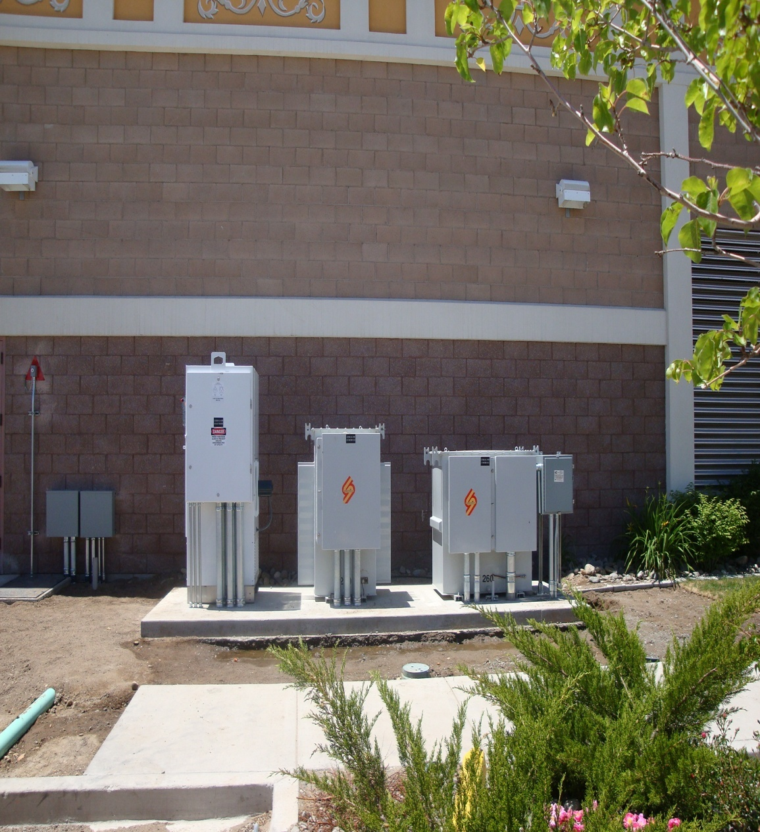
Peppermill Renewable Energy Program
PW #8 – Drive Gear
Central Plant
  Baker Hughes
  Centrilitf Pump
  Centrilitf VFD
  480 Volt – 3 phase transformer
6 stage production pump
  2,000 gpm rated
  Submersible
  Draw down @ 400’

Slide 19
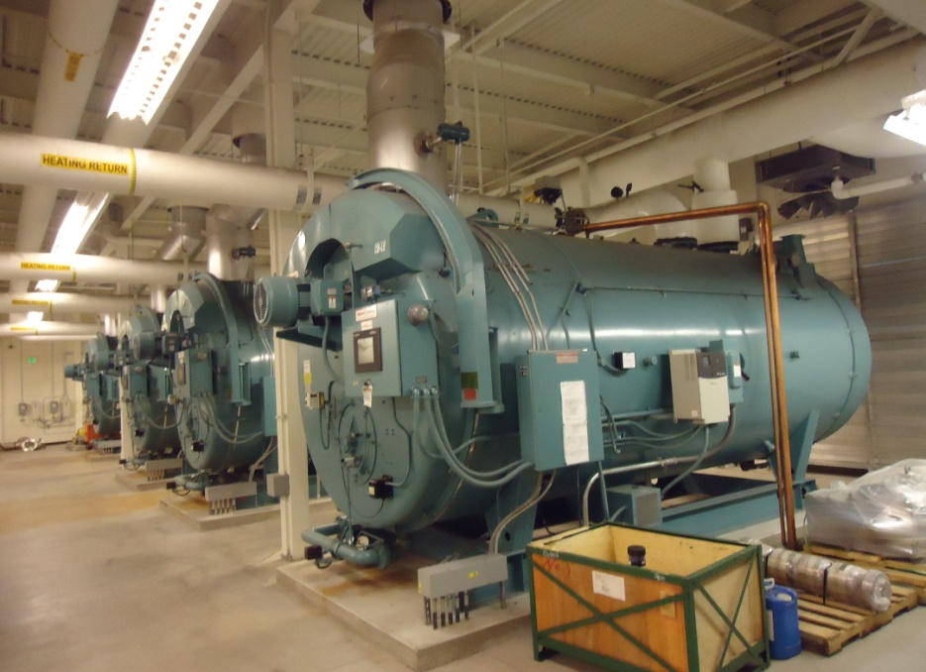
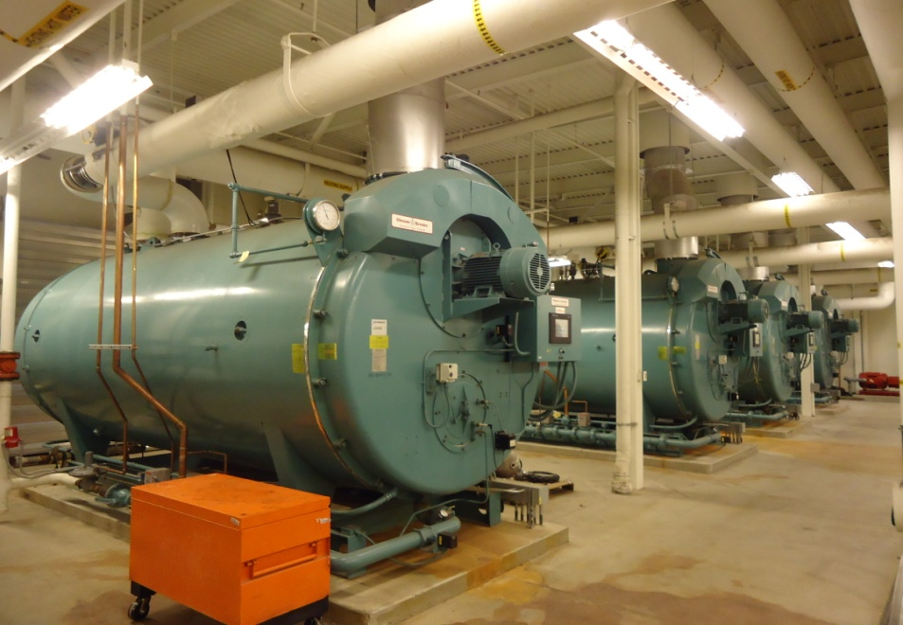
Peppermill Renewable Energy Program
Central Plant Boilers
  Cleaver Brook Boilers
  25,000,000 BTU’s each
    100,000,000 BTU’s total
    Natural Gas driven
  600 HP Boilers
  Annual Consumption
    2,400,000 Therms
    $2,200,000 NG Cost
    Reduce Carbon Footprint by 10,000 pounds.

Slide 20
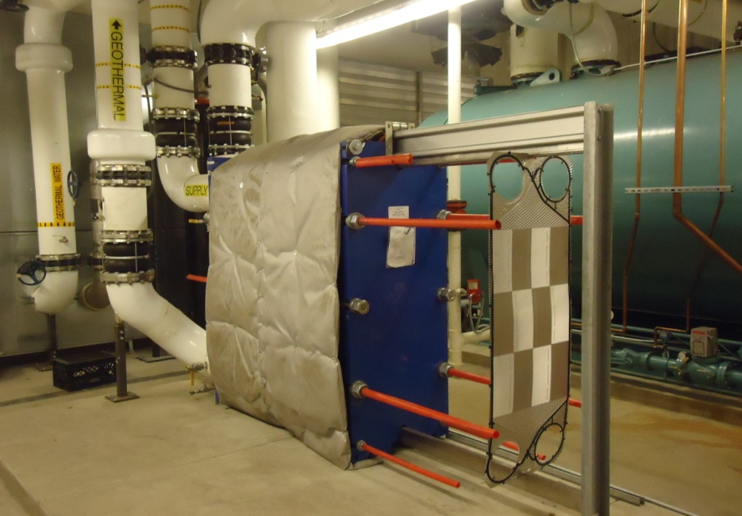
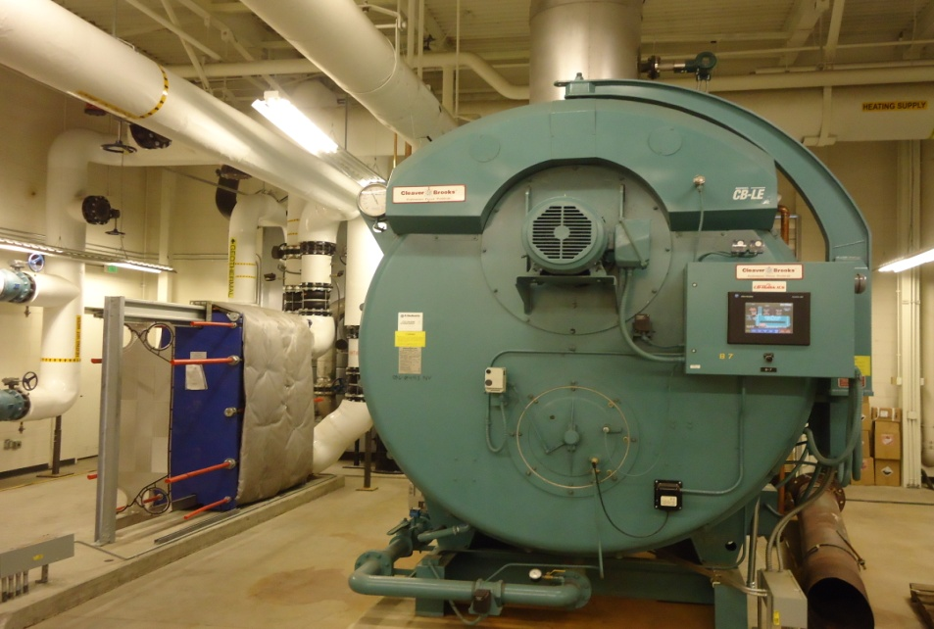
Peppermill Renewable Energy Program
Alfa Laval Heat Exchanger
  Plate & Frame
  1,500 GPM Rated
  Stainless channel plated @ 0.50 mm
  Rated 225 degrees
  Handles 150 p.s.i.g
  Temp meters – Weiss
  Flow meters - McCrometers

Slide 21
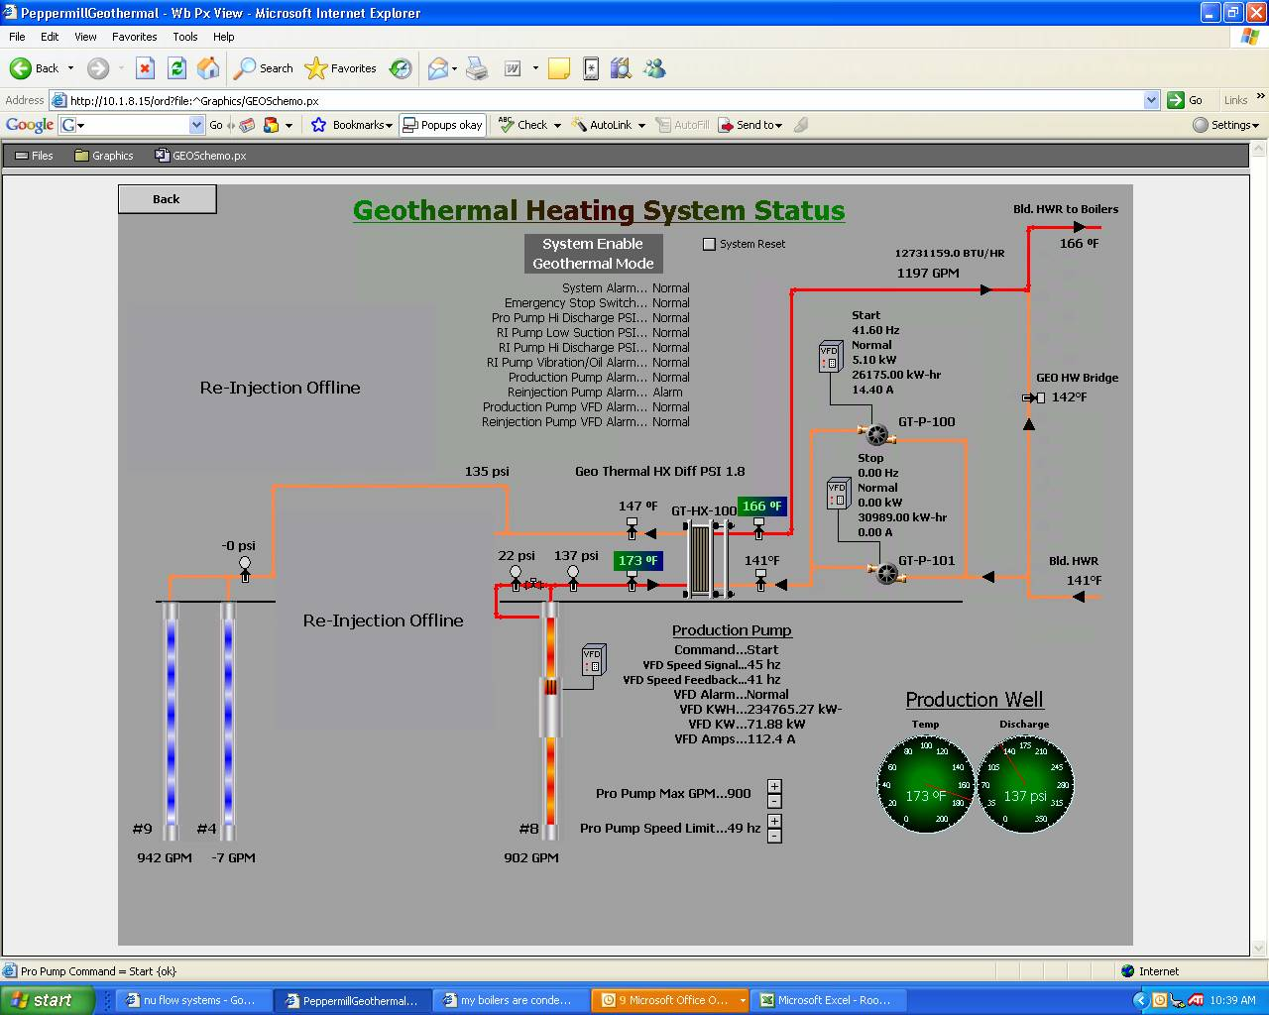
Peppermill Renewable Energy Program
Geothermal Front End – Automating
  Invensys Software
  Geothermal graphic display
  Provides Valuable system Information
  Real Time
  Facility Wide Access

Slide 22
Peppermill Renewable Energy Program
K
3 Year NG History Chart
Started Geothermal July 2010

Slide 23
Peppermill Renewable Energy Program
Future Vision
  Geothermal Electrical Generation
    4 - 6 mega watts
  Alternative Methods
    Geothermal power plant
    Binary - Turbine
  Fuel Cells – not good ROI

Slide 24
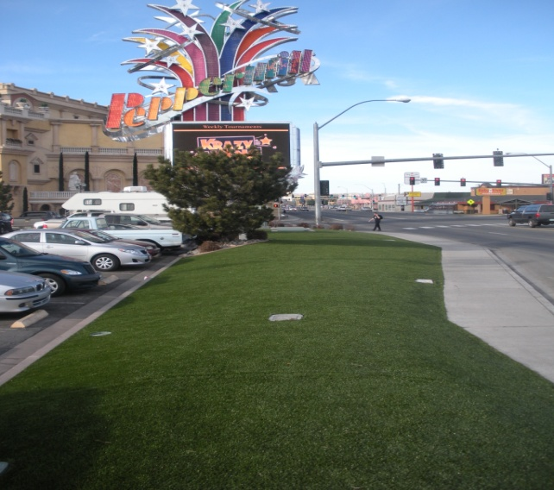
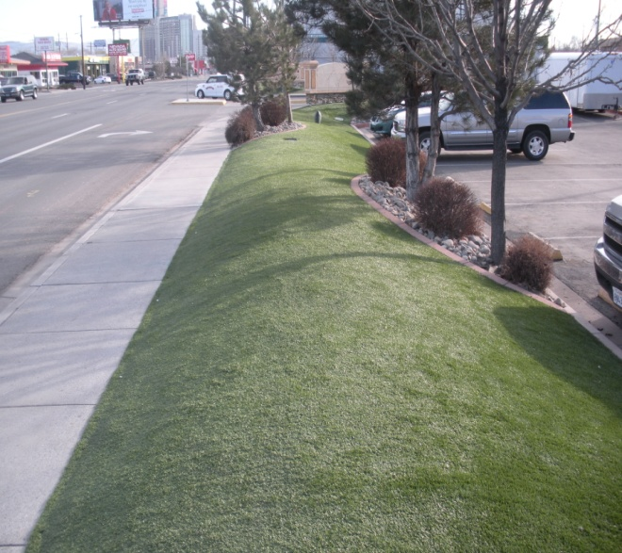
Peppermill Renewable Energy Program
Artificial Grass Turf
  Annual Water Savings
    Replaced 40,000 sq. ft. of grass.
    Removed 120 – 3GPM sprinkler heads
    Rate: $1.72 / 1,000GPM
    5,184,000 Gallons of water savings per season
    $15,000 Annual Savings – Labor & Water use.

Slide 25
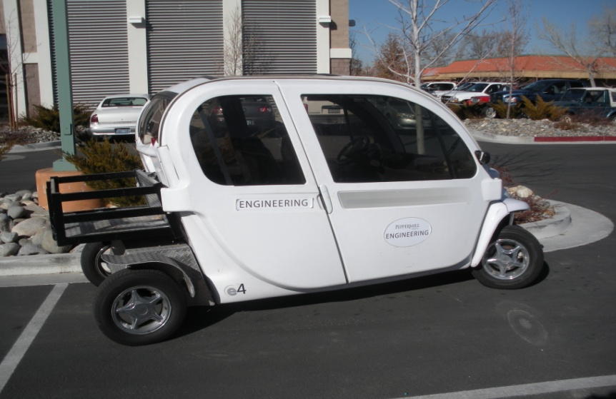
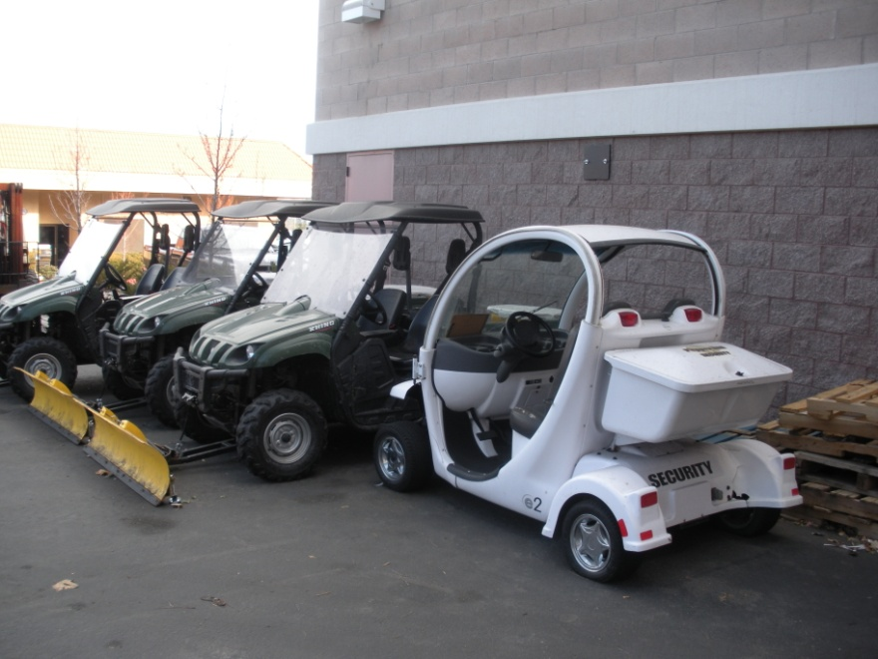
Peppermill Renewable Energy Program
Electric Cars
  Fossil Fuel Savings
    Engineering & Security uses Electric cars
    Goes 8 hours on one charge
    Plugs into 110 Receptacle
    30 – 35 mph

Slide 26
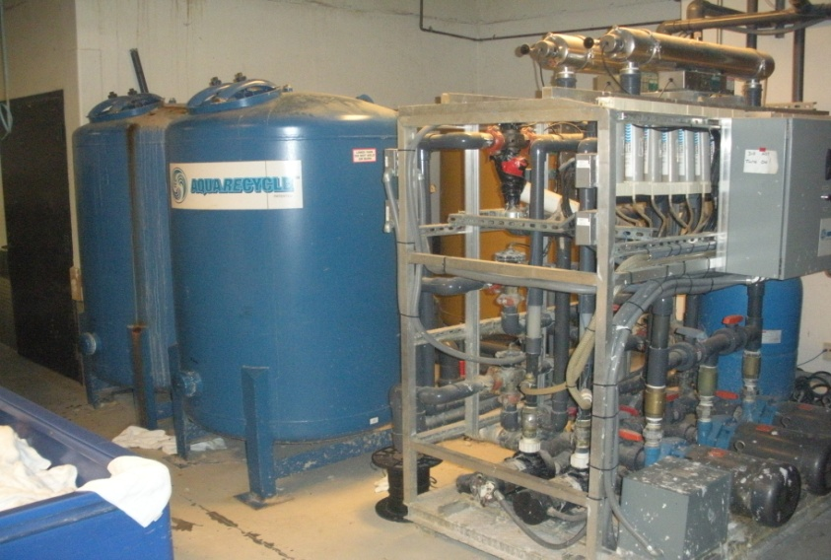
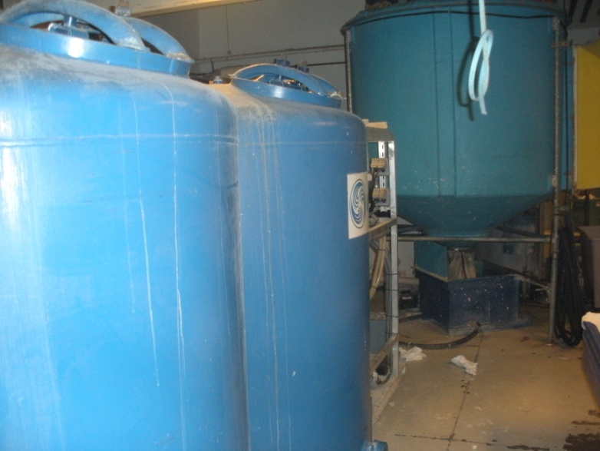
Peppermill Renewable Energy Program
Laundry Grey water recycling
  Aqua Recycling
    Installed 2008
    Capture Grey Wash Water
    Recycled the grey water
    Installation Cost $185,000
  2010 Operational Saving Facts
    Chemical Savings - $123,613
    Water/Sewer Savings - $122,141
    Annual Savings - $245,754
    ROI - 7 1/2 months
  3 - Year Savings Total - $737,264

Slide 27
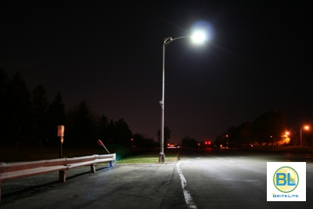
Peppermill Renewable Energy Program
Parking Lot Light Feasibility
  Existing Lights
    300 Metal Halide Lights
    1,000 watts each
    $103,680 Yr Electricity
  LED Light Replacement
    250 Watt with 50,000 hr life
    Unit Cost - $600 per unit
    Total LED Cost - $180,000
    $25,920 Yr Electricity
  ROI
    $ 41,250 - NV Energy Rebate
    $77,760 - Annual Electrical Savings
    1.7 Month - Payback
    $886,464 - Lifetime Savings

