Slide 1
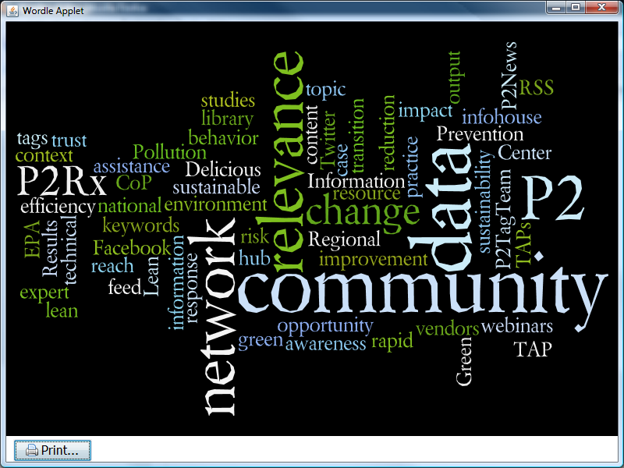
Intro to
Web 2.0 &
Social Media
What it means for TAPs
Rick Yoder, P2RIC
Laura Barnes, GLRPPR

Slide 2
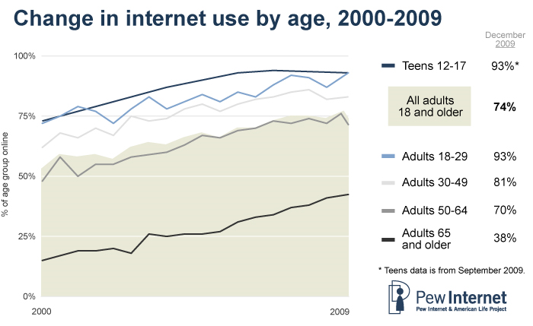
http://www.pewinternet.org/Infographics/2010/Internet-acess-by-age-group-over-time.aspx

Slide 3
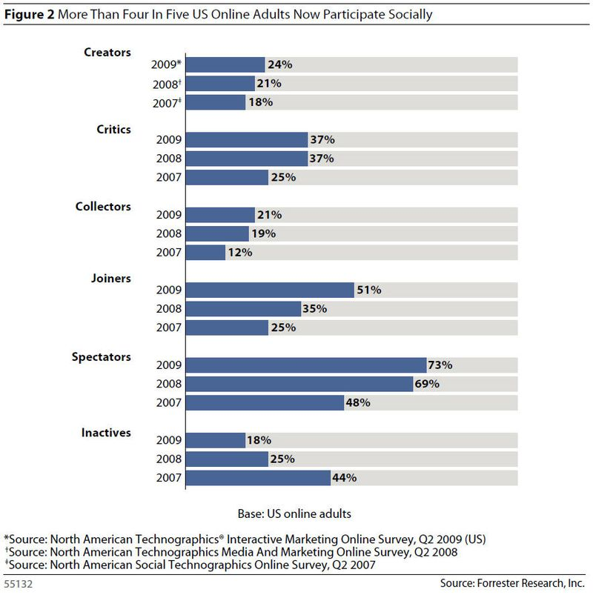








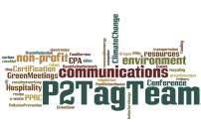









What people are doing
Creators publish: blogs, web pages, articles & stories; upload videos & audio
Conversationalists update their status.
Critics comment: post ratings & reviews; contribute to forums & wikis
Collectors research: use RSS, add tags
Jointers join:
Use social networking sites
Spectators monitor:
read blogs, tweets, forum comments & reviews; watch videos, listen to podcasts
Inactives do none of the above

Slide 4
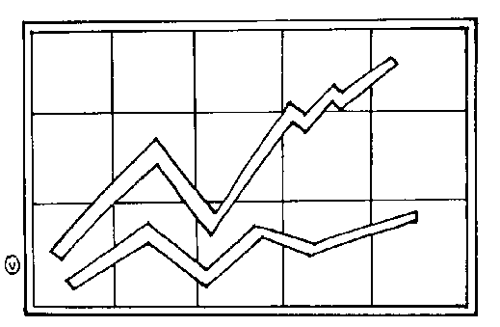
People Use Web 2.0
Wikipedia = 4,000,000 articles
YouTube = >100,000,000 videos
Blogger = >200,000,000 blogs
Facebook = Google: each ~7% all web site visits
73% of active online users have read a blog
45% have started their own blog
39% subscribe to an RSS feed
57% have joined a social network
55% have uploaded photos
83% have watched videos

Slide 5

Don’t Miss the Boat
Start using the tools that are changing the way people discover, share, and communicate.
http://www.epa.gov/epahome/socialmedia.html
http://www.cdc.gov/socialmedia/

Slide 6
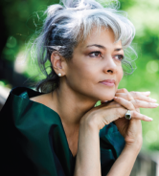
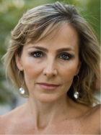
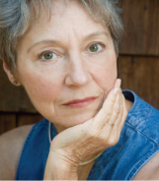
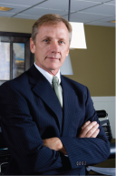
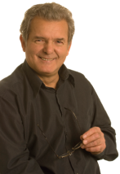
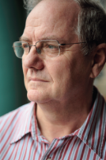
EDUCATION/ COMMUNICATION
MARKETING/
PERSUASION
POLICY/LAW
Sway ‘em
Alarmed
Alice
‘08:18%
’10:10%
Concerned
Claudia
‘08:33%
‘10:29%
Cautious Connie
‘08:19%
‘10:27%
Unconcerned Uri
‘08:12%
‘10: 6%
Doubtful
David
‘08:11%
“10:13%
Dismissive
Dan
‘08: 7%
‘10:16%
Tell ‘em
Make ‘em
INITIATORS
CAUTIONISTS
ALTRUISTS
FREE-RIDERS
Innovators
Early Adopters
Early Majority
Late Majority
Laggards

Slide 7


P2Rx Uses Social Media
Improve Information
Improve Communities
Increase
Trust
Increase Accessibility & Delivery
EDUCATION
PERSUASION
Foster Discussion
Add Value
(tell ‘em)
(sway ‘em)
Discover Info
Expand Reach

Slide 8


Slide 9



Social Media & TAPs
PRODUCT | EXAMPLE | INFORMATION | COMMUNITY
Social Networks | PPRC | Med | High
Feeds and Widgets | P2Rx News | High | Med
Twitter & Microblogs | @P2RIC | Med | Med
Blogging | GLRPPR Blog | High | Med
Social Bookmarking | P2TagTEam | High | Low
Wikis and CMS | P2Rx Wiki | Med | High
Video Sharing & Podcasts | EPA Channel | High | High
Online Calendars | Google Calendar | High | Med
Listservs and Online Discussion Boards | Many | High | High
Email Newsletters | Many | Med | Med
Social Documents | Google Docs, Scribd | Med | Med
Mobile Applications | Good Guide
Mashups & APIs | Google Maps
Social Media Contests
eGames
Advertising – Online & Search
Virtual Worlds

Slide 10
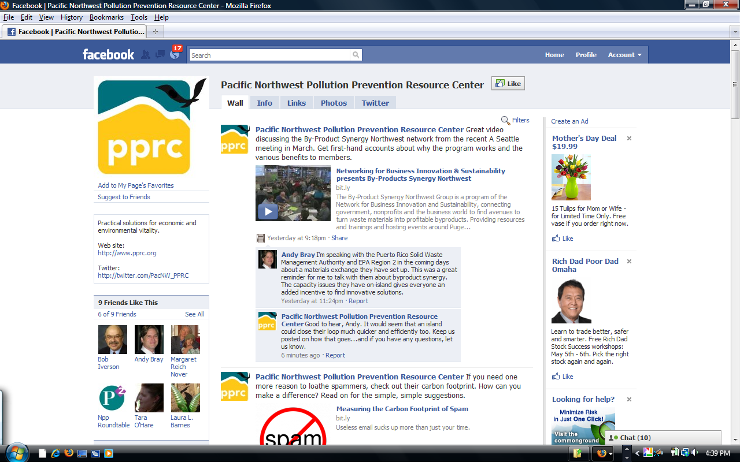
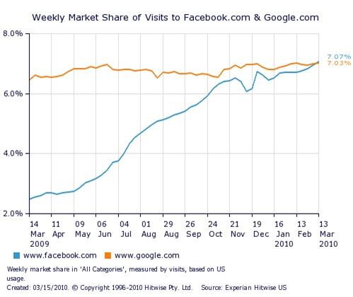
Social Networks
Examples: PPRC, (Facebook), LincolnGreenScene (Ning), Zero Waste, GLRPPR
What: A new, low cost channel of communication. Remember: Google = Facebook in market.
Why: Lets “Joiners” share and discuss likes and content with each other. Allows fans to keep up to date with your news. Increases loyalty, brand.
Metrics: Measure the number of friends/fans, the number of wall-posts and comments left on posted items.
Risks: Privacy issues. ANOTHER site to check/admin.
Information
Find
Improve
Deliver
Community
Talk
Grow
http://www.fastcompany.com/1584920/facebook-now-more-popular-than-google-let-the-ad-wars-begin

Slide 11

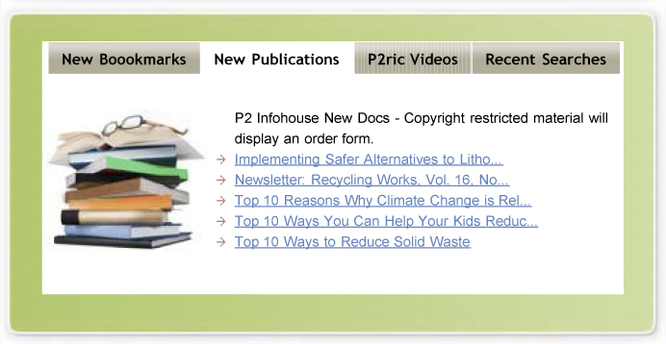

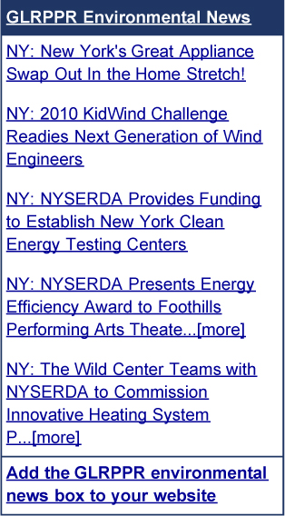
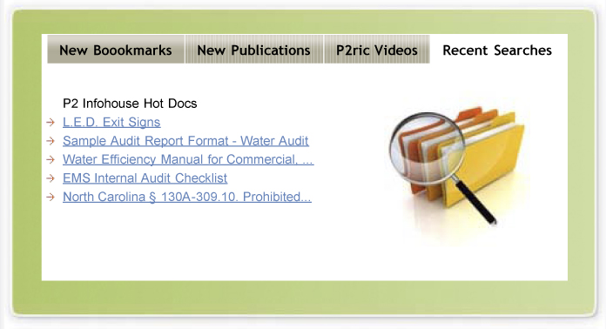
Feeds & Widgets (News In <> News Out)
Examples: P2Rx News, P2 Infohouse Traffic, Yahoo! Pipes, Twitter lists
What: In: News crawl of your preferred sources; Out: Timely information in branded wrapper.
Why: Real time info is good for monitoring others & self- promo, awareness. Adding context improves your credibility.
Metrics: Pageviews, number of “insertions” of your content into other sites; clicks from other sites onto yours through RSS boxes and other functions.
Risk: Quantity v. focus.
Information
Find
Improve
Deliver
Community
Talk
Grow
Take Away: READ & FEED

Slide 12

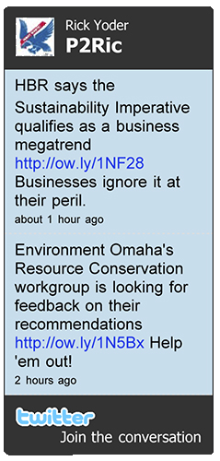
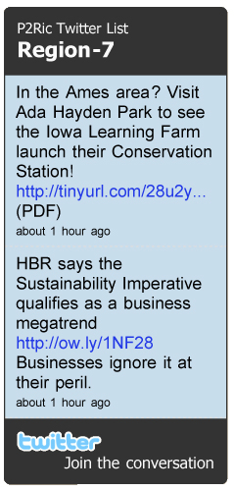
Twitter (& other microblogs)
Examples: @NPPRoundtable, @PacNW_PPRC, @P2Rx, @lisapjackson ,@EnvNewsBits,
Twitter, Facebook, LinkedIn
What: Fast & easy publishing of announcements, events, news. Opinion puts that in context.
Why: Followers receive real-time updates; reciprocity is huge! Build new network, credibility. *LoC*
Metrics: Measure the number of followers, re-tweet and replies to see who is reading and what they think.
Risks: Little bits can get lost in big stream; time management.
Information
Find
Improve
Deliver
Community
Talk
Grow
#Reuse #Reduce #P2
#PreventionPays #P2Rx
TakeAway:
POST & LINK (then send)

Slide 13
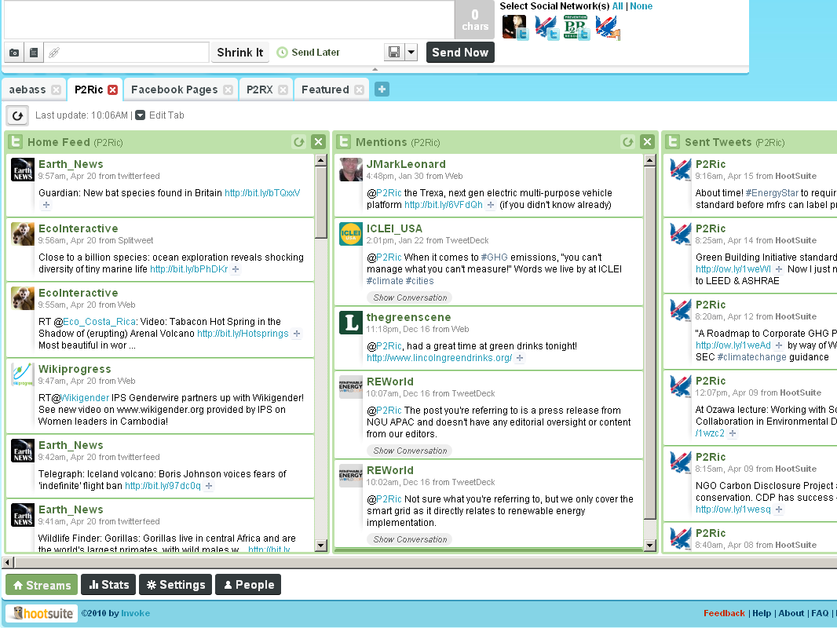
A tool like HootSuite allows you to update several social networks (and blogs) with one, easy-to-use platform (www.hootsuite.com)
TakeAway:
POST & LINK (then send)

Slide 15
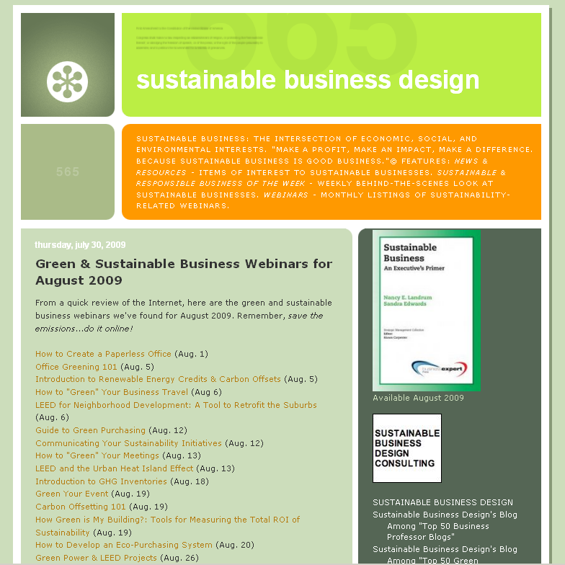
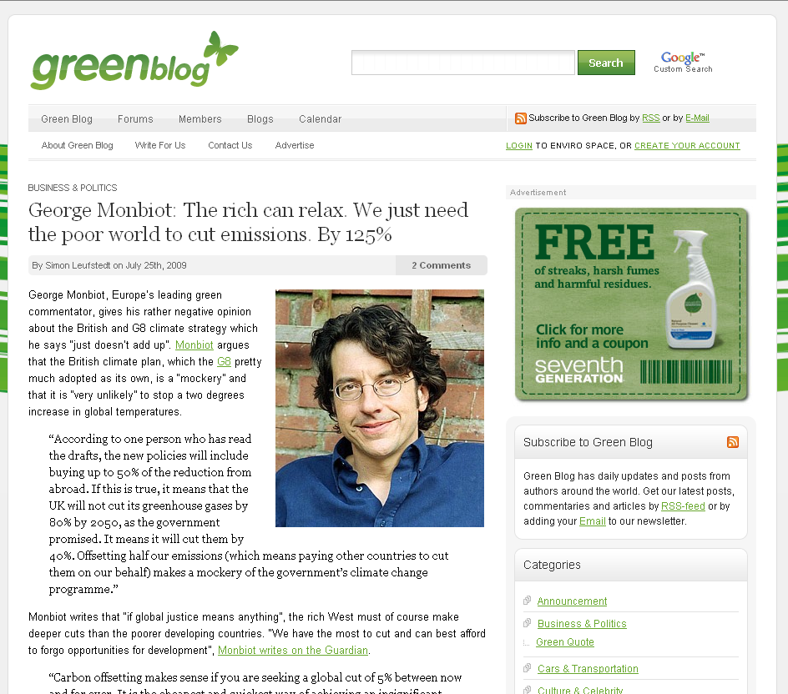
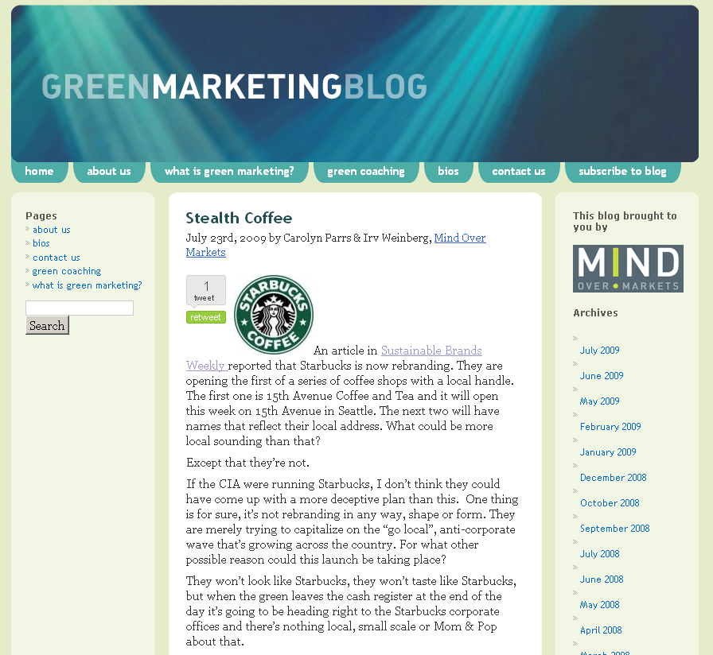

Blogging Through Others (as guests)
Example: GLRPPR Blog
What: Posting guest articles on existing blogs can gain exposure quickly.
Why: Extends the credibility and trust of existing bloggers to you and your products. Moves clients from consideration to preference.
Metrics: Measure number of readers, page views, and comments to see which articles are working best.
Risks: Negligible if you choose the right destinations
Information
Find
Improve
Deliver
Community
Talk
Grow

Slide 16

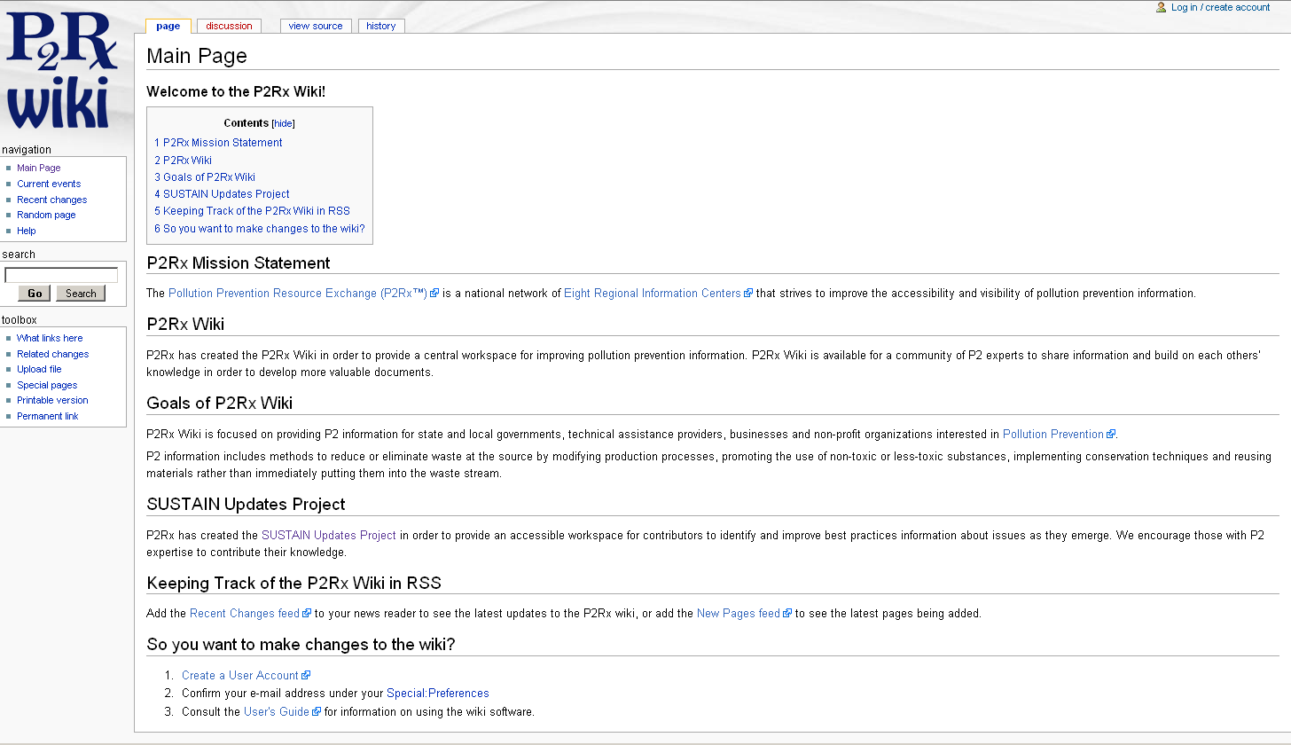

Wikis and CMS
Examples: P2Rx Wiki, SUSTAIN Updates, Toxipedia
What: Documents open to (supervised) community editing.
Why: Allows faster release of content; demonstrate credibility and knowledge; build relationships with community; transparency.
Metrics: Measure number of readers, page views, page edits.
Risks: Learning curve an obstacle to recruitment.
Information
Find
Improve
Access
Community
Talk
Grow
WordPress, a blog platform, works as Content Management System (CMS)

Slide 17
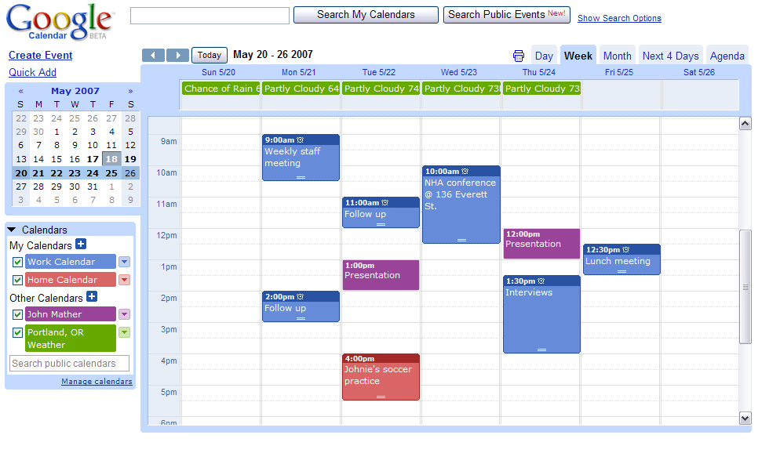
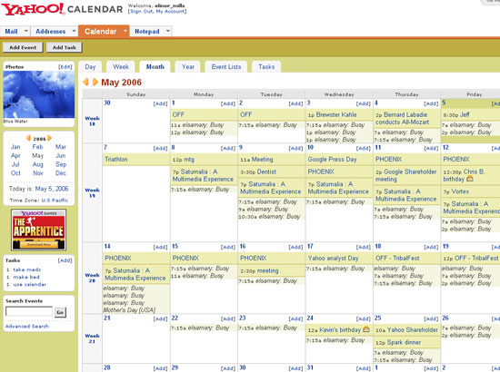
Online Calendars
Example: Google, Yahoo!
What: Underused but effective event marketing technique (anything can become an “event”). Combine with Tweets and blogs to market the events.
Why: Increases engagement and loyalty. Improve scheduling among peer organizations serving shared audiences.
Metrics: Track detail views to see which events are of interest.
Risks: Small loss of branding due to formatting limitations.
Information
Find
Improve
Access
Community
Share
Grow

Slide 18

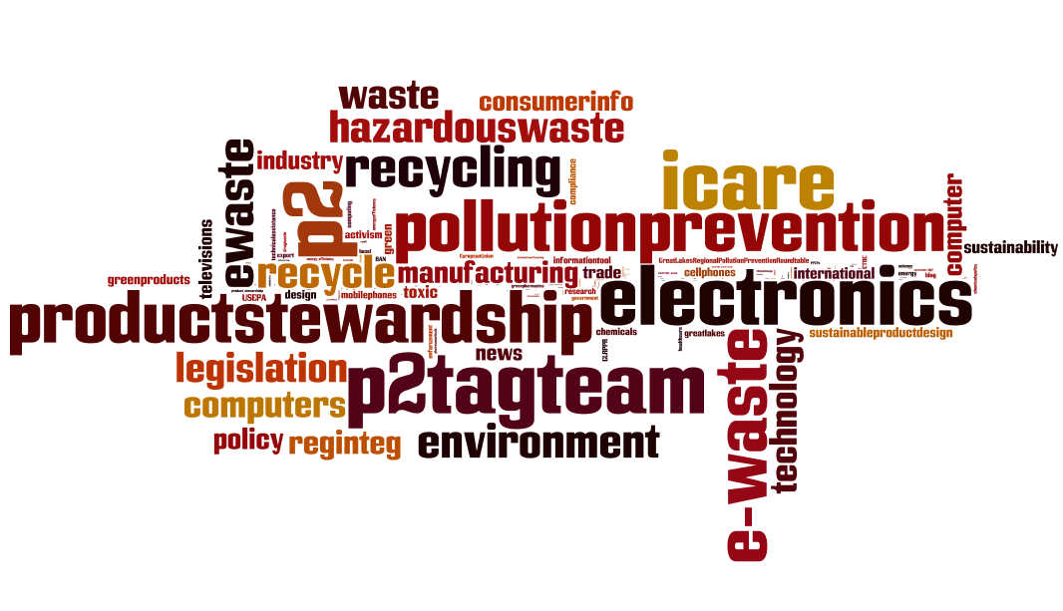
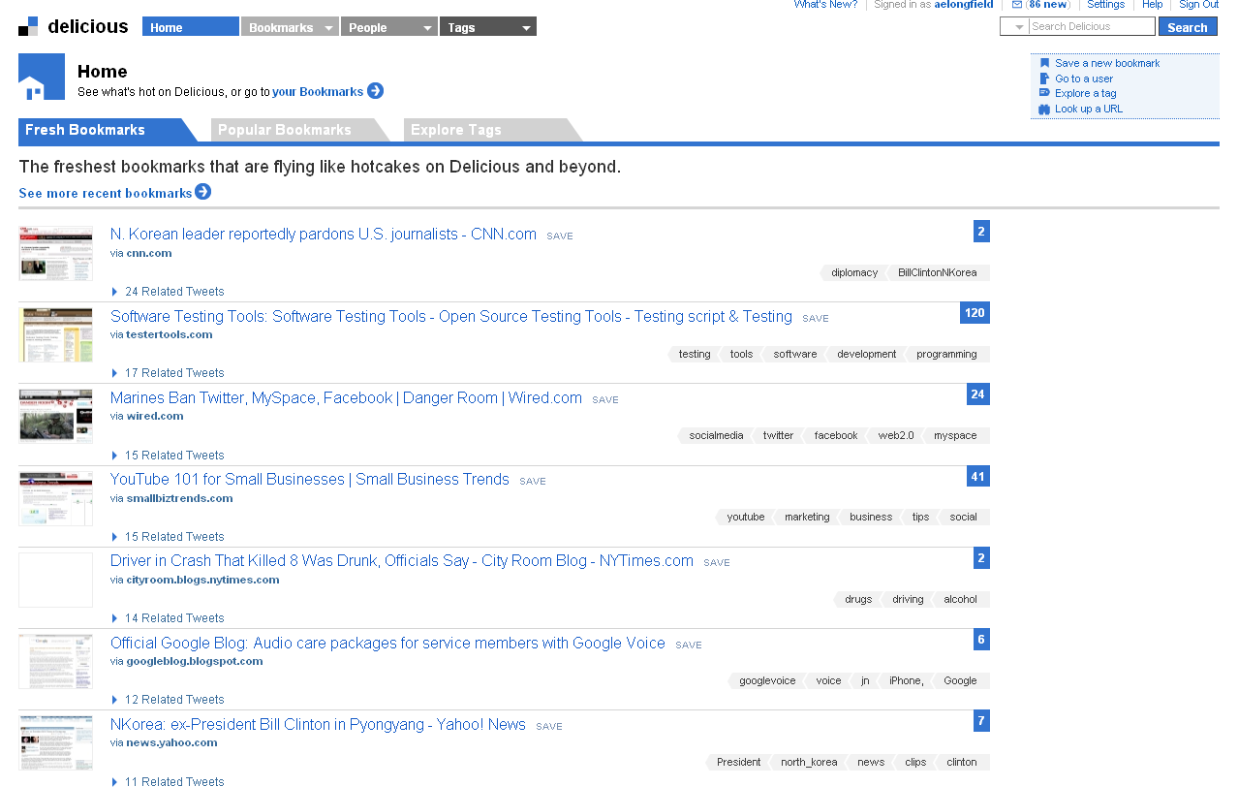
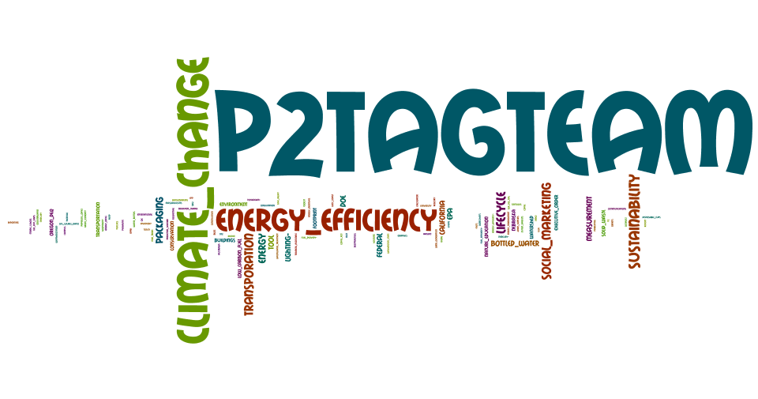
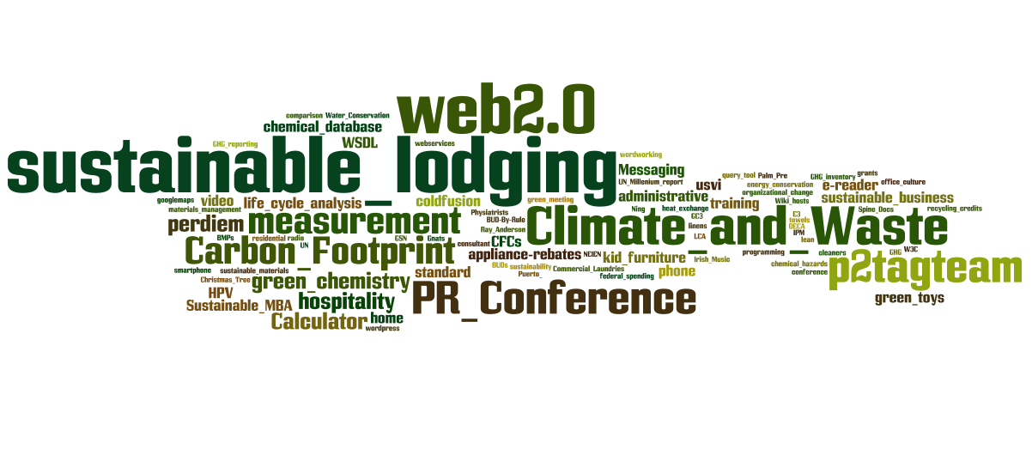
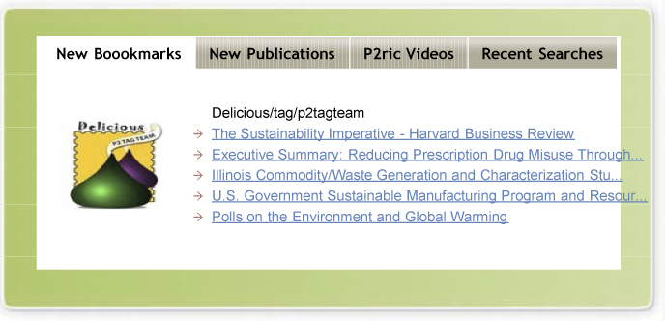
Social Bookmarking
Examples: Delicious P2TagTeam
What: Community identified & shared reference library; better finds than Google of recent information
Why: Increases ability to find and re-find references; grows network & community; data-mining potential to improve community reference base.
Metrics: Rank reference popularity; trend possible, growth in network
Risks: Free service may become fee-for-service
Delicious.com/jeanwaters
Delicious.com/andy_bray
Delicoius.com/jscrogum
Delicious.com/p2ric
Information
Find
Improve
Access
Community
Talk
Grow

Slide 19

Just because everyone else is doing it, does that mean we have to, too?
Be not the first by who the new is tried, nor the last to lay the old aside. -Alexander Pope

Slide 21
Resources
Forrester research about on-line markets:
http://forrester.typepad.com/groundswell/2010/01/conversationalists-get-onto-the-ladder.html
Data about internet usage:
http://www.pewinternet.org/
http://www.pewinternet.org/Infographics/Generational-differences-in-online-activities.aspx
Useful federal social media sites
http://www.usa.gov/webcontent/technology/other_tech.shtml
http://www.cdc.gov/socialmedia/
http://www.epa.gov/epahome/socialmedia.html

Slide 22
Richard Yoder, PE
UNO – CBA – NBDC
P2RIC Director
6001 Dodge St. MH200R
Omaha, NE 68182
402.554.6257
ryoder@unomaha.edu
www.p2ric.org
Serving R7 = IA, KS, MO, NE

