Slide 1

Webinar: “Fryer to Fuel and other Sustainable Biodiesel Models”

Slide 2
Webinar Instructions
This webinar will be muted to reduce or eliminate external auditory disturbances;
The webinar will be available for download at www.wsppn.org .
If you are experiencing technical difficulties, please call toll free at 1-800-263-6317, or direct at 1-805-617-7000. Press 2 when prompted.
Brought to you by:
The Western Sustainability Pollution Prevention Network (WSPPN)
The Nevada Business Environmental Program (BEP)
  for free and confidential services, call toll-free at 1-800-882-3233

Slide 3


Slide 4
Biodiesel Webinar Agenda
10:00 am
10:05
10:25
10:30
10:50
10:55
11:20
11:25
11:30 am
Webinar Purpose, Instructions for Attendees
Olof Hansen, U.S. EPA Region 9 (San Francisco, CA)
Q&A
Jo Fleming – Ecology Action (Santa Cruz, CA)
Q&A
Carlo Luri, Bently Biofuels (Minden, NV)
Q&A
Information & Resources
Adjourn

Slide 5
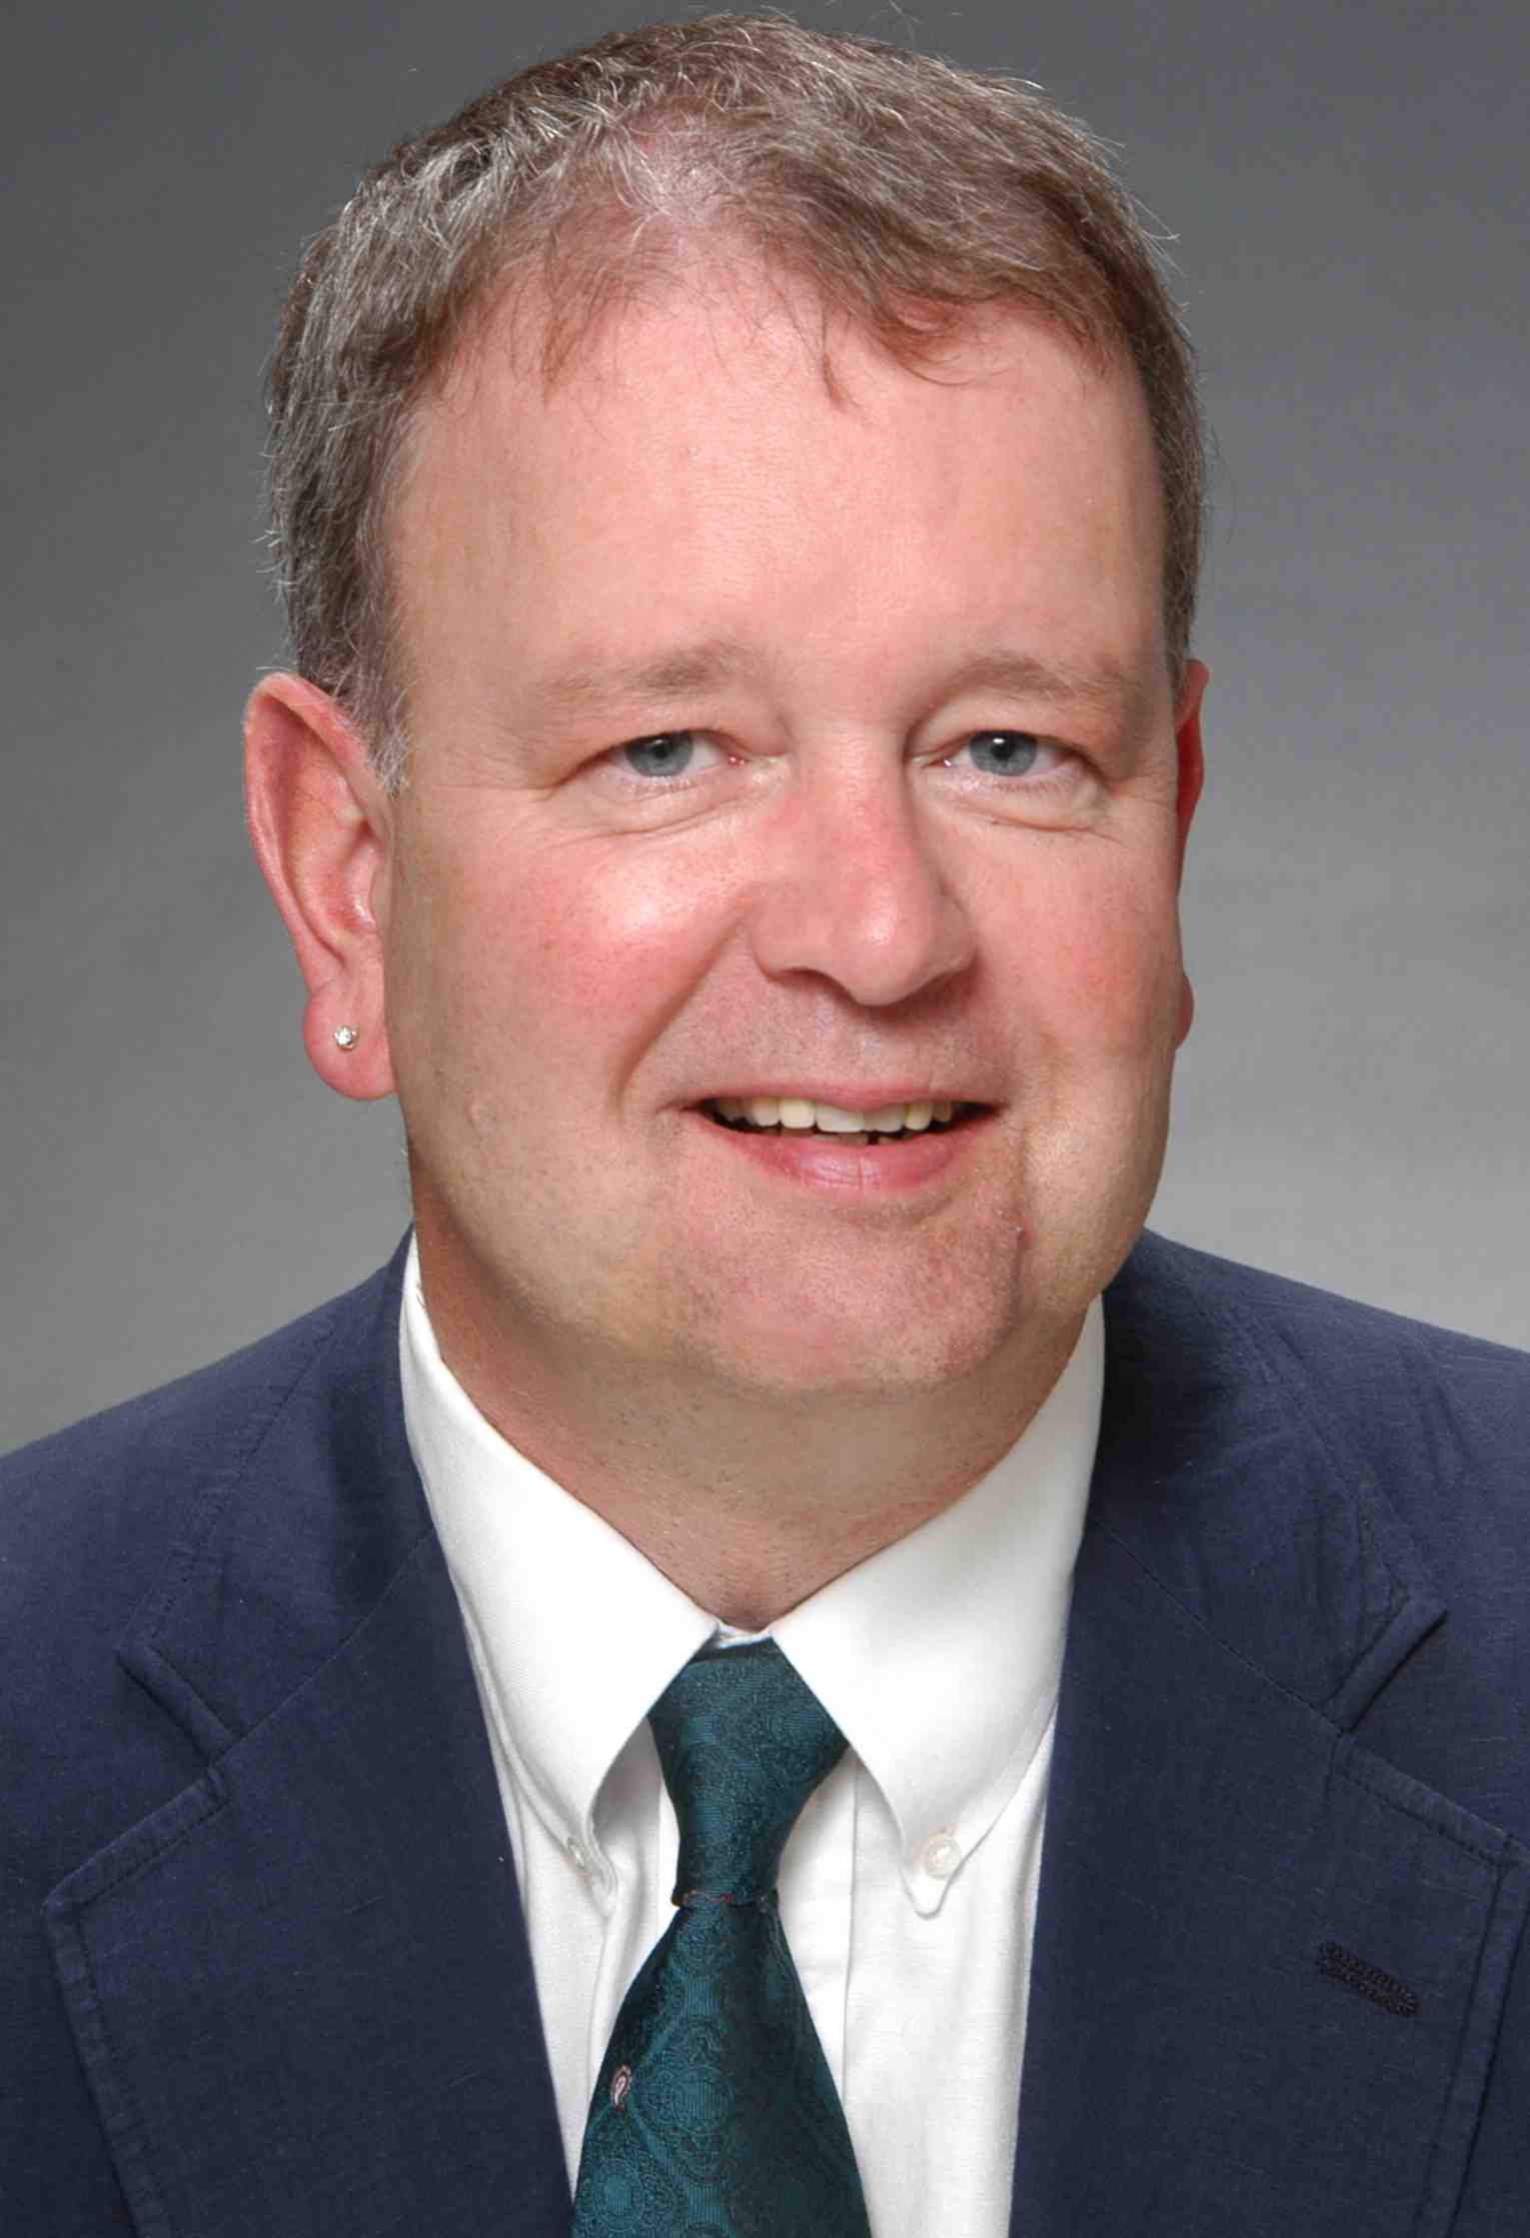
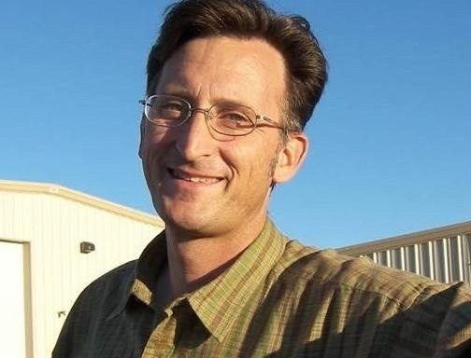
Olof Hansen
U.S. EPA Region 9
San Francisco, CA
Jo Fleming – Owner Ecology Action
Santa Cruz, CA
Carlo Luri, General Mngr.
Bently Biofuels
Minden, NV

Slide 6
Information & Resources
Call To Action! Biodiesel FET Credit Extension Needs Your Support Now!
  http://www.biodiesel.com/index.php/company/press/call_to_action
On-line Resources
Bently Biofuels Company bentlybiofuels.com
BTS Fuel Testing biodieseltesting.com
National Biodiesel Board biodiesel.org
Pacific Biodiesel biodiesel.com
Sustainable Biodiesel Alliance fuelresponsibly.org
Dept. of Energy Alternative Fuels Data Center afdc.energy.gov/afdc
National Renewable Energy Lab nrel.gov
NearBio - Biodiesel Locator nearbio.com
Region 9 Biodiesel Resources – www.epa.gov/region 9/waste/biodiesel

Slide 7

Thank You for Your Participation!

