Slide 1
Blogging Tips and Tricks
By Laura Barnes

Slide 2
What are blogs?
Publishing tools that allow you to write and distribute anything you want
Blogs also allow you to interact with your readers via comments
A blog can be a
News feed
Marketing tool
Online journal
The Julie/Julia Project
Political rant
Whatever you want it to be

Slide 3
I don’t know what to write about
Write what you know and what you care about
Highlight useful resources
Summarize a current project
Share your take on a current issue or problem
KISS (Keep it short and straightforward)
Informal tone is OK (even preferable)
Short, punchy paragraphs are easy to scan
Tell a story to pull your reader into the post
End with an open-ended question to invite comment and discussion

Slide 4
Fresh content is important
Frequent posts = more traffic to your site
Assign someone to write posts and solicit content from guest bloggers
Locating and writing good content takes time
An editorial calendar gives direction
Assign topics if your writers have trouble thinking of ideas
Have fun with it
Not all posts have to deal with serious topics
Environmental humor
Inspiration from popular culture
Environmentalism in The Simpsons
Off-beat stories or topics
Green fashion

Slide 5
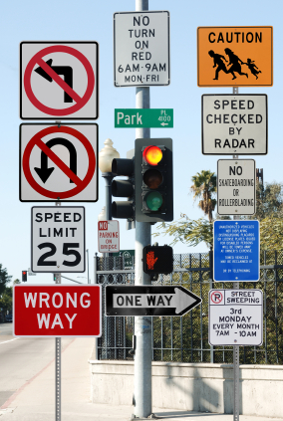
Drowning in information?

Slide 6

Surrender isn’t the only option
Notes:
6

Slide 7
Ways We Look for Information
Search
When: You’re doing research or trying to answer a question
Where: Google, Bing, Yahoo, your favorite search engine, the colleague down the hall
Scan
When: You’re trying to keep up with a topic
Where: Trusted news sources
Building community with social media enables you to earn credibility and become a trusted news source

Slide 8

When you
do it effectively!
Notes:
8

Slide 9
Use Your Time Wisely
Do a preliminary web search
If you haven’t found it in 10-15 minutes, ask a librarian or an expert
GLRPPR Help Desk Librarian http://www.glrppr.org/helpdesk
Your local technical assistance program
P2Rx Rapid Response
Your local public, school, community college, or university librarian
Use browser add-ons to help you sort through results
Search Cloudlet
Deeper Web

Slide 10
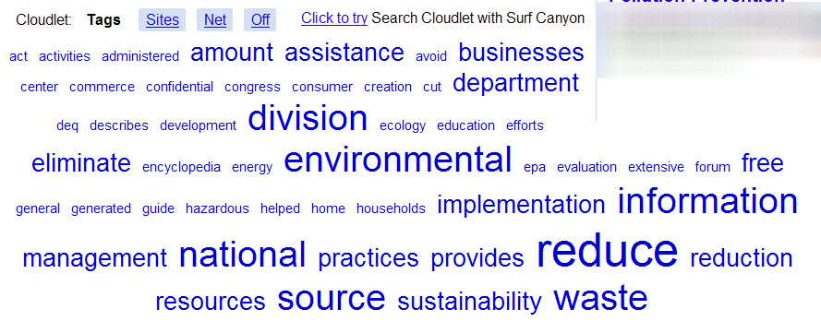
Search Cloudlet Sample Search – Pollution Prevention

Slide 11
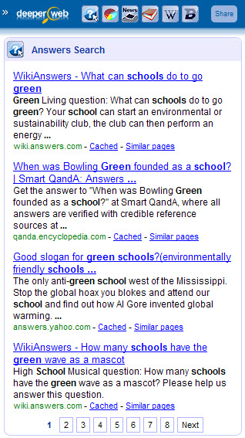
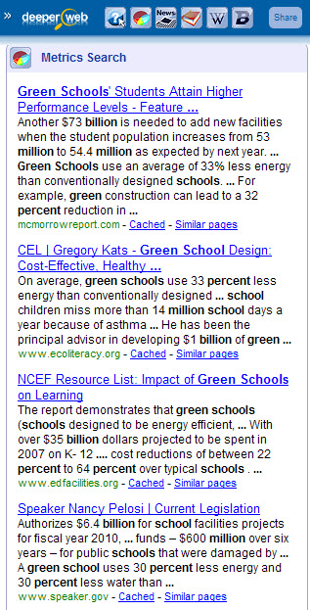
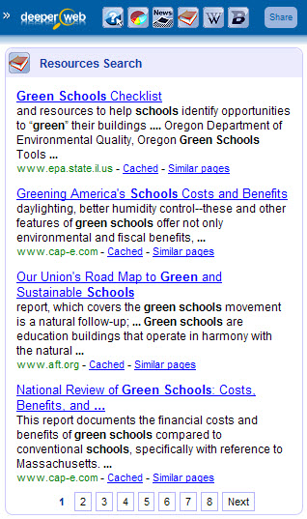
Deeper Web Sample Search – Green Schools

Slide 12
Don’t Believe Everything You Read
Choose your sources carefully
Use local resources first
Library resources are evaluated before purchase
Don’t assume that the web has the most recent or the best information
Trust but verify
Always check to see how current a page is
Always look for information about the author of the page

Slide 13
Use the Appropriate Tool
Use Google, Bing when you’re looking for something specific, an unusual term, or an exact phrase
Use advanced search features to refine your search
Use a directory when you’re looking for lots of information on a particular topic
GLRPPR Sector Resources
Don’t forget the database resources at your local library

Slide 14
Be Flexible
Because search engines aren’t
Google is a noun, not a verb
Try different search engines
Blind Search
Bing vs. Google
Try variations on your search terms
Pollution prevention
Source reduction
Green purchasing
Environmentally preferable purchasing
Buying green
Product stewardship
Extended producer responsibility

Slide 15
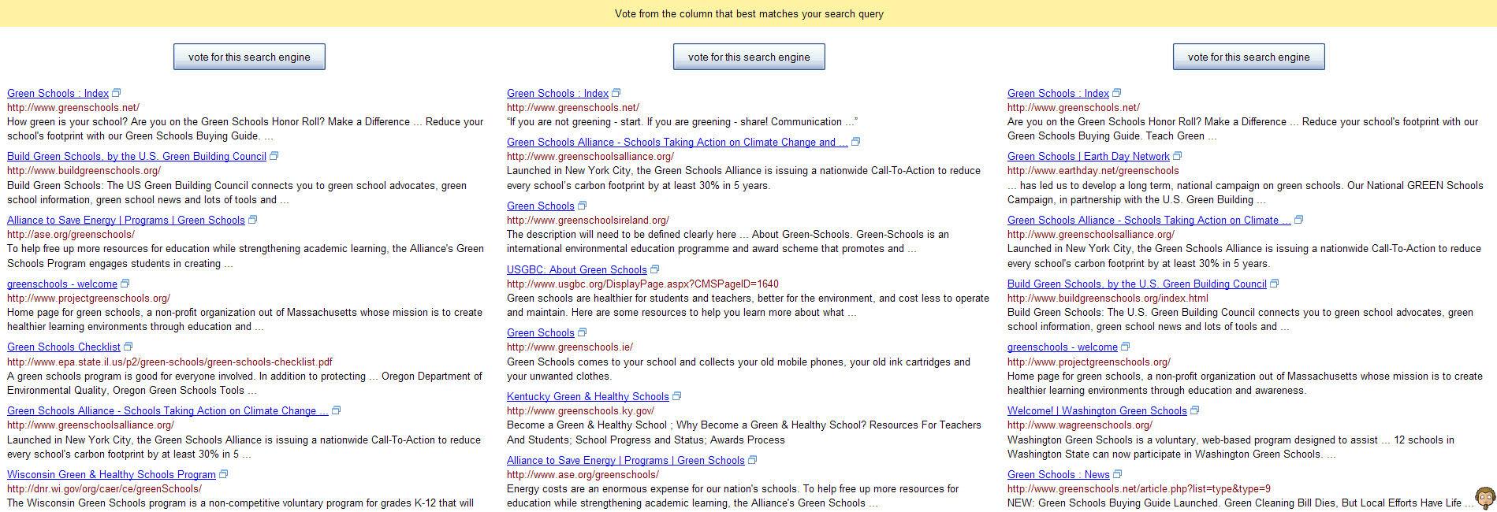
Blind Search – Green Schools

Slide 16
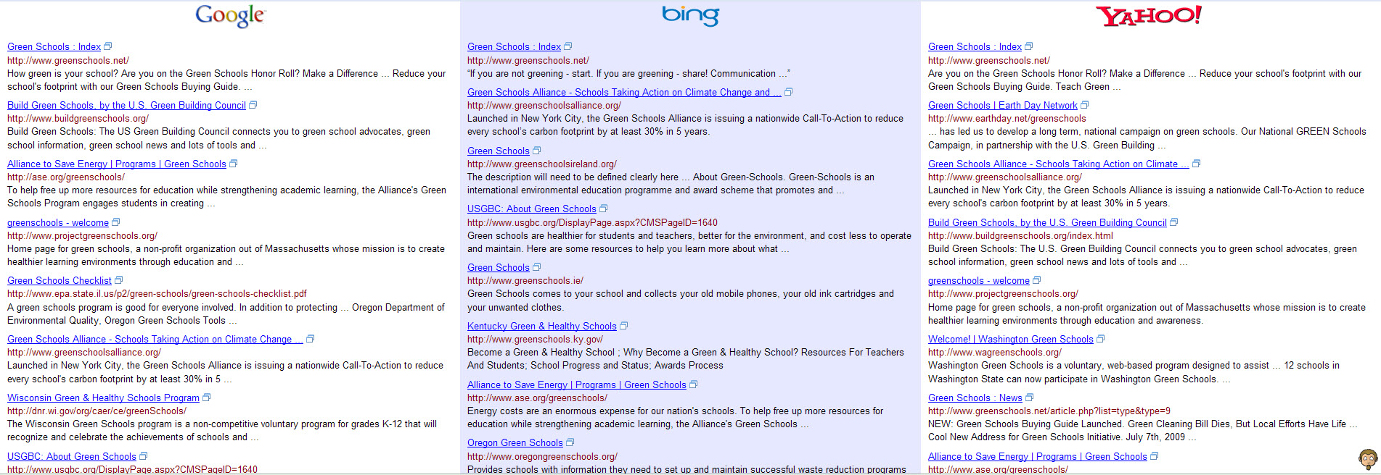
Blind Search – Green Schools

Slide 17
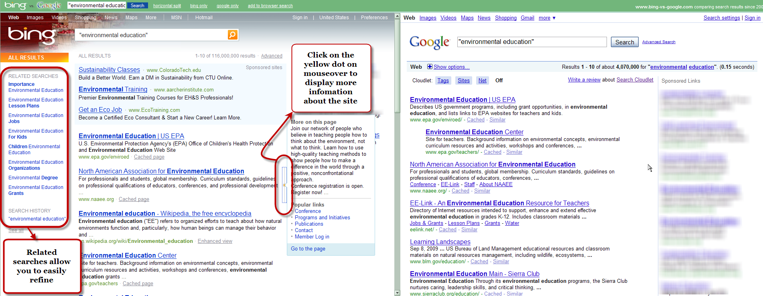
Bing vs. Google – Environmental Education

Slide 18

It isn’t always on the Internet!
Notes:
18

Slide 19

If my inbox weren’t electronic, it would look like this…only much, much messier.
Notes:
19

Slide 20

RSS is your friend
Notes:
20

Slide 21
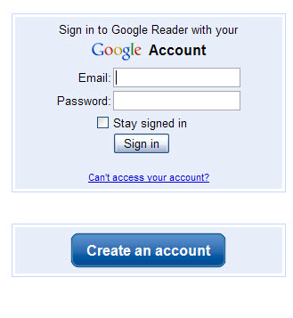
Google Reader
Notes:
21

Slide 22
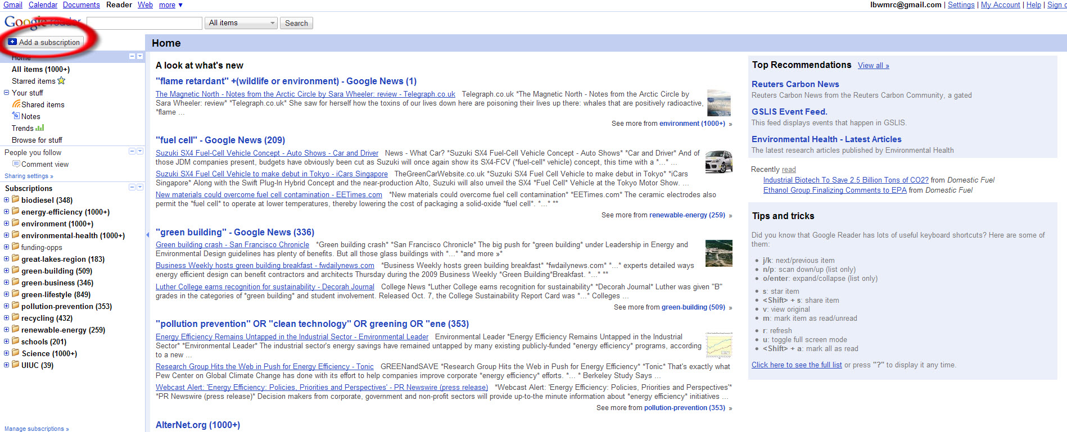
Google Reader – Add a Subscription
Notes:
22

Slide 23
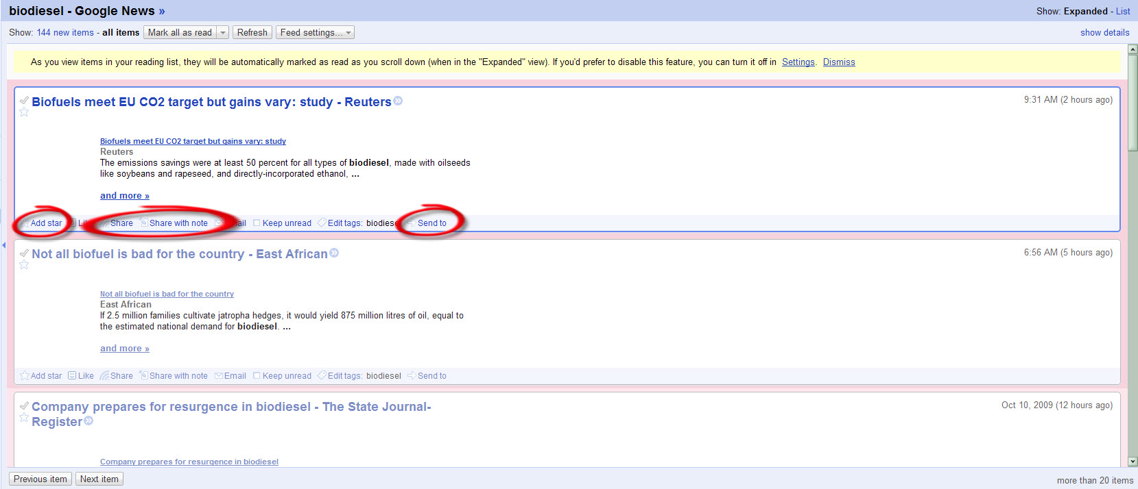
Google Reader – Feed Page
Notes:
23

Slide 24
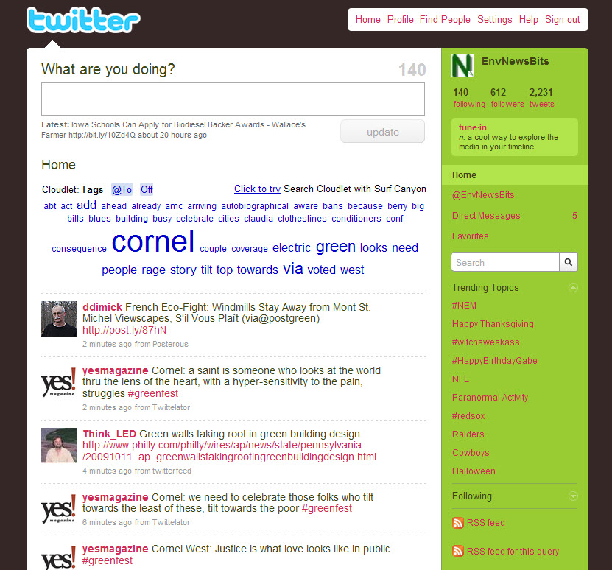

Slide 25

What’s that web site I wanted to show you?
Bookmark Fail

Slide 26
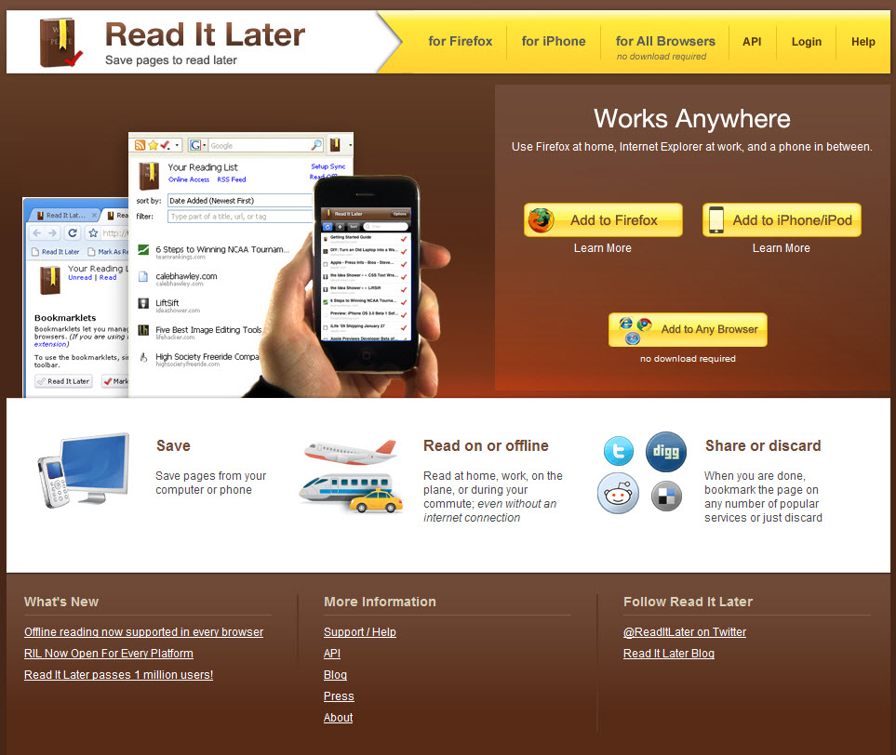

Slide 27
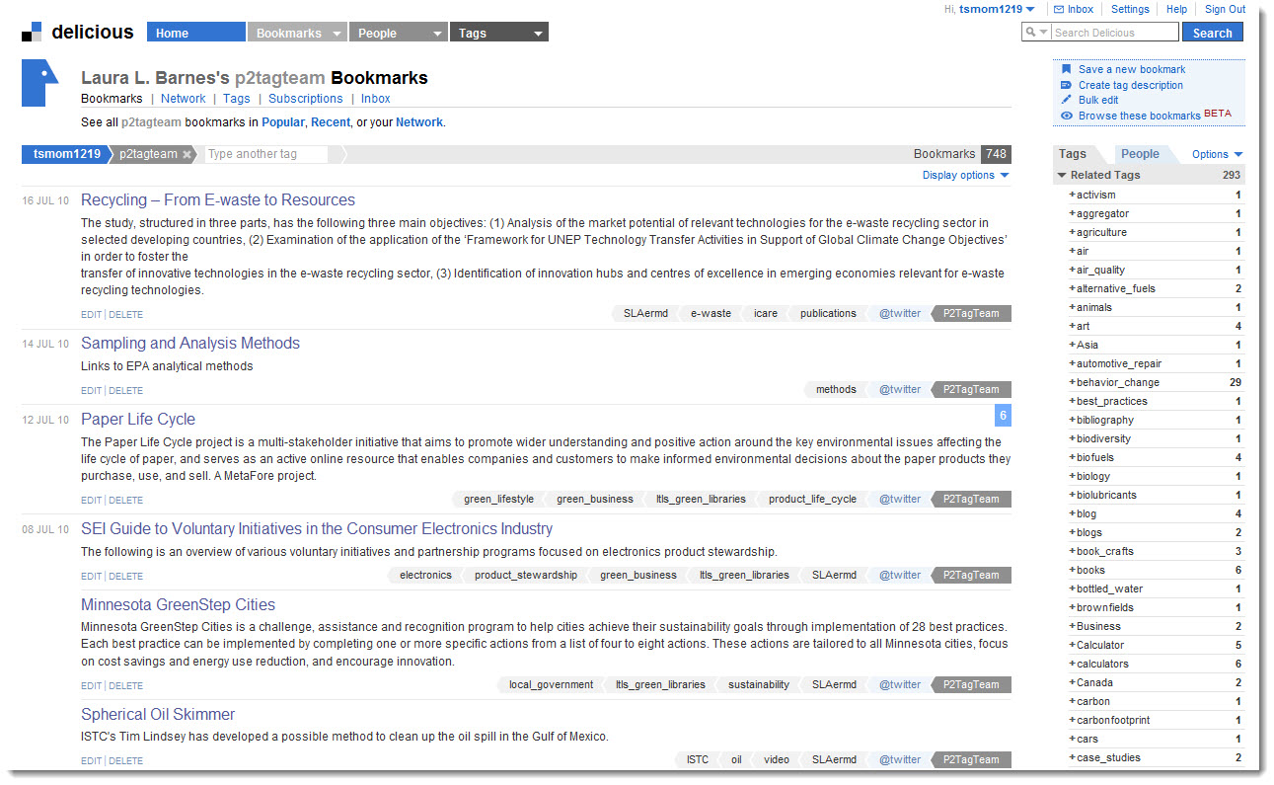

Slide 28

YES!!! I found it! And it didn’t take three hours!

Slide 29
Program Takeaways
Social media tools are useful for delivering/sharing information and building community
Use social networking tools to bring together the people you know and the resources you have
By using social marketing principles, your organization can build credibility and to become a trusted information source

