Slide 1

Web 2.0 Social Networking Webinar July 28, 2010

Slide 2

Hosted By WSPPN

Slide 3
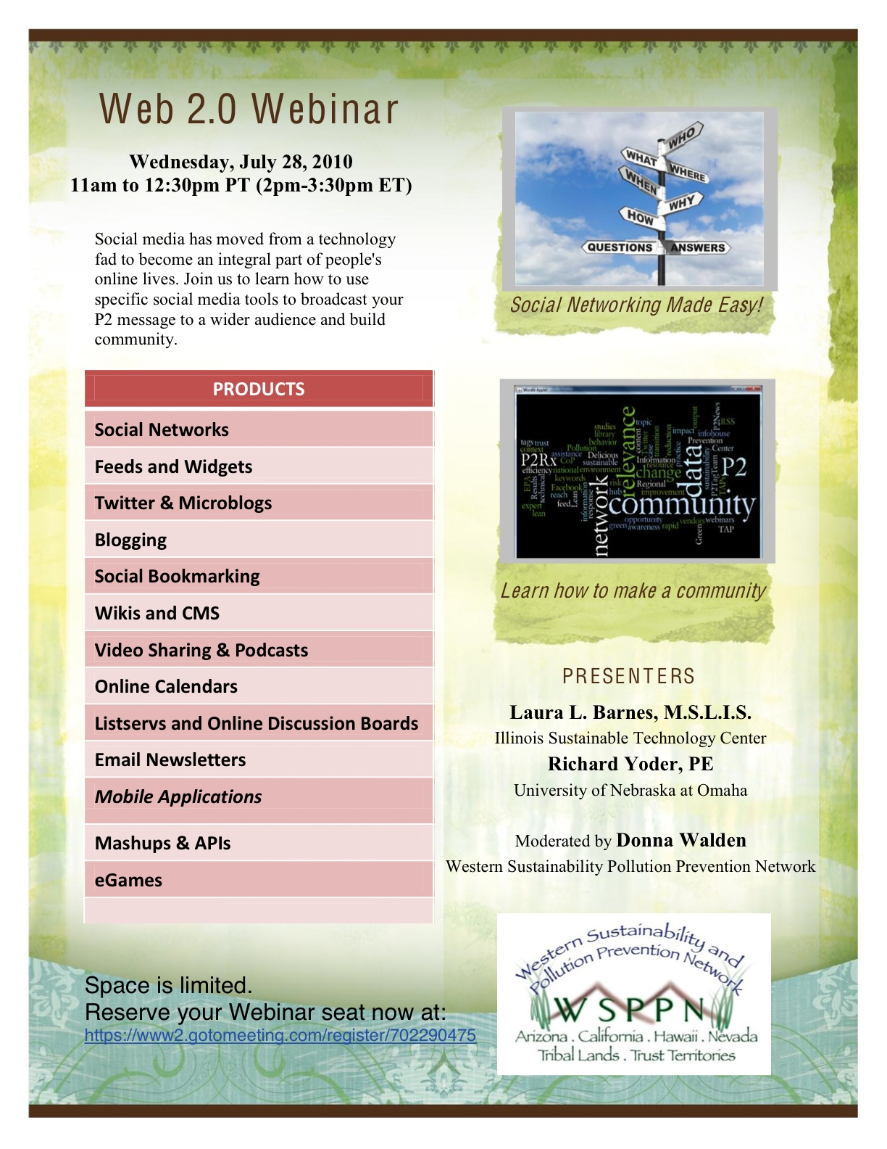
Webinar Agenda
Social Media and Why It’s Important
Social Media & P2Rx
Information
Building Communities
Q&A
Tools & Trade-Offs
Q&A
How to Deal with Information Overload
Summary & Resources
Q&A

Slide 4


Presenters
Rick Yoder – P2RIC – University of Nebraska at Omaha
Laura Barnes – Illinois Sustainable Technology Center

Slide 5
Useful Links:
Useful Firefox Add-Ons:
Bing vs. Google http://bvsg.org/ Blind Search http://blindsearch.fejus.com/ Environmental News Bits http://lib.wmrc.uiuc.edu/enb GLRPPR Help Desk http://www.glrppr.org/helpdesk/ GLRPPR Sector Resources http://www.glrppr.org/sectors P2Rx Rapid Response http://www.p2rx.org/services/rapidresponse.cfm Google Reader http://reader.google.com Laura L. Barnes' Delicious Bookmarks http://delicious.com/tsmom1219
Deeper Web http://www.deeperweb.com/ Search Cloudlet http://www.getcloudlet.com/ Read It Later http://readitlaterlist.com/

Slide 6
Thank You!
See Webinar on www.wsppn.org

